Slide 1
Introducción al
R C M
(Reliability Centered Maintenance)
MANTENIMIENTO CENTRADO EN CONFIABILIDAD

Slide 2
INTRODUCCIÓN
Durante los últimos años la idea general del mantenimiento ha cambiado debido a múltiples factores como aumento de la mecanización y de la complejidad de la maquinaria, nuevas tecnologías y a un nuevo enfoque de la organización del mantenimiento.
Adicionalmente, una mayor exigencia en aspectos de seguridad y medio ambiente junto a la identificación de la conexión entre mantenimiento y la calidad del producto.
Mantenimiento está buscando un nuevo camino, buscando evitar equivocarse en alguna acción de mejora emprendida. RCM parece ser el camino correcto

Slide 3
EL CAMBIANTE MUNDO DEL MANTENIMIENTO
PRIMERA GENERACION (..... A 1950)
  Industria poco mecanizada
  Maquinas sencillas y robustas
  No importaba mucho los periodos de paradas
  Repara en casos de fallas
  Patrón de falla (Desgaste por vida)
SEGUNDA GENERACION (1950 A 1975)
  Características de la Industria:
      Maquinas de todo tipo y mas complejas
      La industria dependía de las maquinas
  Expectativas del Mantenimiento:
      Mayor disponibilidad
      Mayor vida de equipos
      Menores costos
      Prevenir las fallas

Slide 4
EL CAMBIANTE MUNDO DEL MANTENIMIENTO
SEGUNDA GENERACION (Cont.)
  Respuesta de Mantenimiento:
      Cambio de componentes (por horas de operación)
      Overhaules (por horas de operación)
      Uso de estadísticas
      Programas de cambio de componentes
  Patrón de falla (Fallas al inicio y desgaste por vida)
TERCERA GENERACION (1975 A HOY)
  Características de la Industria
      Maquinas mucho mas complejas
  Expectativas del Mantenimiento:
      Mayor disponibilidad y confiabilidad de equipos
      Mejor calidad del producto
      Mayor vida de equipos
      Mayor seguridad

Slide 5
EL CAMBIANTE MUNDO DEL MANTENIMIENTO
TERCERA GENERACION (Cont.)
      No dañar el medio ambiente
      Mayor costo-efectividad del mantenimiento.
  Respuesta de Mantenimiento:
      Monitoreo de condiciones
      Nuevas técnicas de Mantenimiento
      Diseño de equipos más confiables y más mantenibles
      Sistemas expertos
      Estudios de riesgos
      PC pequeños y rápidos
      Análisis de efectos y modos de fallas (FMEA)
      Cuadrillas de trabajos y técnicos multitareas

Slide 6
EL CAMBIANTE MUNDO DEL MANTENIMIENTO
Figura 1.2. Puntos de vista cambiantes sobre la falla de equipos

Slide 7
TIPOS DE MANTENIMIENTO
1. MANTENIMIENTO CORRECTIVO: Es aquel que devuelve el equipo a sus condiciones estándares de operación después de la ocurrencia de una falla.
CARACTERISTICAS:
    Es de carácter urgente
    Requiere solución inmediata
    Paradas inesperadas
    Elevados requerimientos de personal
    Costoso para la producción
    Daños cuantiosos al parque industrial
    70 - 30

Slide 8
TIPOS DE MANTENIMIENTO
2. MANTENIMIENTO PREVENTIVO: Es el que se hace para prevenir fallas en el equipo. Inspeccionando y cambiando componentes por horas.
CARACTERISTICAS:
    Inspecciones periódicas
    Usa estadísticas
    Verifica ajustes
    Planea y programa para cambio de componentes y partes.
    Menores requerimientos de personal
    Mayor vida útil de equipos
    Menores paradas imprevistas
    Mejora la seguridad.

Slide 9
TIPOS DE MANTENIMIENTO
3. MANTENIMIENTO PREDICTIVO: Hace seguimiento a variables físicas (vibraciones, temperaturas......) para determinar cuando una falla ha comenzado en un equipo,componente o parte y programar su reparación o cambio.
CARACTERISTICAS:
    Utiliza equipos sofisticados
    Es útil en fallas progresivas
    Optimiza los ciclos de mantenimiento preventivo
    Reduce labores de mantenimiento.

Slide 10
QUÉ ES RCM ?
    Es un proceso técnico y lógico que se desarrolla para determinar las tareas de mantenimiento necesarias para alcanzar la confiabilidad de diseño de plantas, equipos, sistemas, componentes, en su contexto operacional.
    Es ampliamente conocido como la manera más costo - efectiva para desarrollar estrategias de mantenimiento clase mundial.

Slide 11
QUÉ ES RCM ?
Curva de la Bañera

Slide 12
Mantenimiento Centrado en Confiabilidad
SEIS PATRONES DE FALLA

Slide 13
RCM : SIETE PREGUNTAS BÁSICAS
  El RCM se basa en las siete preguntas siguientes:
    Cuáles son las funciones y el desempeño esperado del equipo ?
    De qué forma puede fallar el equipo en cumplir sus funciones y el desempeño esperado ? (fallas funcionales)
    Cuáles son las causas para que el equipo falle en cumplir sus funciones y el desempeño esperado ? (modos de falla)
    Qué sucede o cómo se manifiesta cada falla ? (efectos)
    Qué ocurre si falla? ( consecuencias)
    Qué puede hacerse para prevenir o predecir cada falla ? (tareas proactivas e intervalos)
    Qué hacer si no se encuentra una tarea proactiva adecuada? (acciones a falta de)

Slide 14
Pregunta 1 - Funciones
FUNCIONES PRIMARIAS
Son las razones por la cual el equipo fue adquirido y se expresa en términos de:
        Producción
        Capacidad de transporte
        Capacidad de almacenaje
        Velocidad
        Calidad del producto
        Servicio al cliente
Ejemplo: Función de un reactor químico en una planta: “Calentar 500 kgs de reactivo desde la temperatura ambiente hasta el punto ebullición (125 °C) en una hora”

Slide 15
Funciones
Enunciado de la Función
El enunciado de la función debe comenzar con un verbo y generalmente contiene un verbo (infinitivo), un objeto y al menos un estándar de desempeño
(Bombear agua a una rata mínima de 300 litros por minuto)

Slide 16
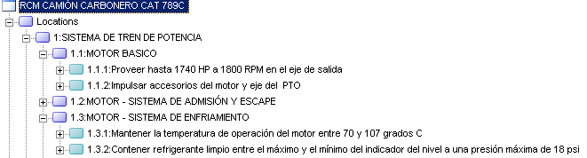
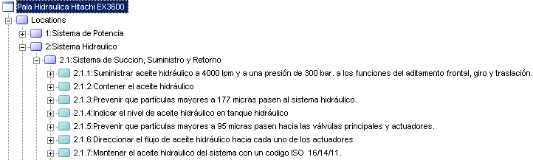
Pregunta 1 - Funciones

Slide 17
Funciones
• Primaria •
Para que compramos el equipo.
• Secundarias •
Otras funciones necesarias para su operación
Notes:
Primary functions spell out why we bought this asset. Socratic stuff - What's the primary function of a chair? To support body, very often the answer you'll get. So does a bed... What is it that distinguishes a bed and chair's function? In a seated position.
How much body? up to a maximum of 50Kg. 200 Kg in a seated position.
Sign outside a factory. Very interesting one. Usual one - advertising. Communicate who is in there: Performance expectations - visible from a certain distance. By whom? A normally sighted person. By day or by nite? Then need to bring in concept of lighting.
Filling machine: To fill so many cans of beans per minute to within +- of a desired weight. Without damage to can.
Putting and between two verbs - to fold and close - rather make it two functions.
Exterior walls of a house: (for the civil guys) Isolate occupants from weather. To support the roof.
Can overstate the difference between primary and secondary. Some people get overly excited about secondary that they forget the primaries.
Chair exercise: very crucial "so-what" from the fact that the simpler the functionality the more reliable the asset - the more functions the more maintenance and the less reliable. Which chair is likely to fail more often? which will require more maintenance?

Slide 18

Funciones Secundarias
• Entorno / Medio Ambiente
Seguridad / Integridad Estructural
Control / Contener / Confort
Apariencia
Protección (Dispositivos de Prot.)
Economía / Eficiencia
Superfluas
La función primaria de una silla, es soportar una persona de hasta 150 kilos en posición sentada.
Cuáles son las funciones secundarias de esta silla?
Funciones
Notes:
first little exercise - chair
secondary functions
35 mm projector - became obsolete
kettle - US people don't know what the primary function is, use microwave
dropped it altogether - went straight into benzene system or conveyor.
That was too heavy as a first exercise.
office chair - not likely to become obsolete, is surprisingly complex, will find it wherever you run a course. Want one which has wheels, goes round, goes back and forward. You do this exercise in pairs. Ask group to list the secondary functions of a chair.
environmental integrety, safety structural integity,
control/containment/comfort, appearance, protection,
economy/efficiency, superfluous functions
to be able to move chair with a force of 5 lb
to be able to adjust elevation from 30 in to 40"
to be able to adjust inclination from 90 deg to 120 deg
to be able to spring back to 90 deg position
to be able to turn 360 deg
environmental
to not issue toxic gas when burning
to not ignite below 250 deg F
control/containment/comfort
to prevent falling when inclining up to 120 deg
to maintain comfort for up to 7.5 hours for a normal person
We hand out sheet.
We want people to quantify performance standards wherever possible.
Timing is going to be an issue. How much time to spend on it. These exercises offer an opportunity to moderate your time. Spend more or less time depending on how you're doing. However don't spend more than 15 minutes.
The next slide provides the solution (suggested solution) which you also hand out.

Slide 19
Las Funciones de una Silla de Oficina
1.Soportar persona (s) de hasta 150 kilos en posición sentada.
2. Permitir al ocupante permanecer sentado hasta 2 horas de manera confortable.
3. Permitir al ocupante ajustar la altura de la silla entre 460 y 580 mm sobre el piso.
4. Permitir al ocupante inclinar el conjunto del asiento 20° hacia atrás desde la horizontal.
5. Permitir al ocupante reclinar el conjunto del asiento hacia atrás entre 0° y 20° desde la horizontal.
6. Permitir al ocupante fijar el conjunto del asiento en cualquier ángulo entre 0° y 20° hacia atrás desde la horizontal.
7. Permitir al ocupante girar el asiento 360° en el plano horizontal.
8. Permitir al ocupante ajustar el ángulo del respaldo entre 90° y 110° respecto del asiento.
9. Soportar los antebrazos del ocupante mientras está sentado hacia atrás.
10. Rodar a lo largo de una alfombra en un piso horizontal cuando se le empuja con una fuerza de 2 kgs.
11. No dañar la alfombra cuando rueda sobre el piso.
12. No lastimar al ocupante si usa cualquiera de los mecanismos de ajuste.
13. Lucir compatible con la decoración del cuarto en donde está siendo usada.
14. Permitir a cualquier trabajador de oficina normal levantar la silla sin riesgo de lastimarse.
15. Mantenerse intacta cuando se levanta.
16. No inflamarse cuando se la expone a un cigarrillo encendido, a la llama de una cerilla o a un encendedor.
17. No liberar sustancias tóxicas en el caso de un incendio.
Funciones
Notes:
Quite a lot of lessons to be drawn from this exercise
- a hell of a lot of functions
- this can be a drawback - might create the impression that a relatively more complex machine would be impossible. In actual fact, surprising as it may seem the avg typical equipment has only 20 - 25 functions. All chairs don't have 18 functions. Why did the mfg give it all these functions? Your own crude chairs fill the functions remarkably well.
- another conclusion - which one is likely to be less reliable? The more functions, the more likely it is to fail.
- if you go over 40 functions in a system – sub-systems should be broken out.
- it's worth running through some of the functions.
to rock
to lock - this chair can't do that
to rotate
adjust angle of back relative to seat - this chair can't do that
support forearms of occupant
not to damage the carpet
not to harm the occupant while adjusting
appearance:
what do we mean by acceptable - (meld with decor)
to enable occupant to lift without difficulty
to remain intact when lifted
not to catch fire wen exposed ot a burning cigarette or the frame of a
match or lighter
not to release toxic substances if caught in a conflagration
not to fall over
how the oxford dictionary defines comfort negative way - freedom from anxiety, pain, grief.
The RCM facilitator sizes each system so that you come up to about 30 functions
Protection - adds a lot of functions
One starts by just looking at the chair. The existence of a component implies a function. We focus not on the component as the object of the analysis but rather we ask what it does. This mental exercise brings out multiple perspectives in order to ensure that all functions are covered. Run through the obvious ones. Then go through ESCAPE/PEACHES.
OK guys what about what this chair looks like? What about safety?
You can write negative function statements; e.g. "not to" often easier to express. - not to allow current to flow to earth through case. Most of the "not to"s related to safety.
Look at p&id, or look at the thing itself. Then go through ESCAPE. Ah yes, forgot about that. Don’t be rigorous with it. Strangely, if you get too rigorous you sometimes miss the obvious ones.
The main hoist of a traveling (gantry) crane. Has it all - the safety protection. And you can see it all. Don't need the ESCAPE mnemonic.
Guys were not seriously recommending you go out and analyze all your office chairs. Except if you're maintaining them, or are about to buy a few thousand. In the real world we don't seriously analyze office chairs. This was just to give you a flavor of how the process works. We will be getting into a real example next.
Question: If a regulator has specified a maintenance program, should we do RCM on that? Very important point. Competitors say no. Turn to page 103. RCM and safety legislation. Read through it with group. Concept of audit trail. Rational defensible basis for maintenance program. Answer is yes. Because in the huge majority of cases RCM will come up with different tasks or intervals. It is wise to continue to do the tasks
specified by the law, and discuss with regulator concerned. The law says this - my analysis says do that. Most regulators say ok. If he says no, he is now taking personal responsibility for the safety of your equipment. More and more regulators are beginning to understand this. Another interesting point: the huge majority of tasks that are specified by law, if you ask why is this task specified and at this interval, they
cannot answer. Custom and practice. Goes back into the mists of time.
Overstressing tests - insane in my opinion. Use non-invasive rapidly developing predictive type test. You'll come up with a faster better technology which will stand up in court. Here's my task and here's my reason for doing it. What's the rationale behind yours? They are surprisingly amenable to changing the regulation. Don't break the law.
Exception: nuclear industry - regulators tend to say no. Our competitors give the opposite advice “i.e. do what the regulation says and forget it.”
Very often one disastrous event inspires a truckload of laws. Political backlash. Important word - "defensible". More and more likely that the analyst goes to jail. Exciting development in PAM. Australia – they sent the whole team to jail.
Australia - world's most advanced maintenance economy. Very big mining industry. Hostile aggressive environment. Active economies far from OEM suppliers. Also South Africa. Into 3rd generation of CMMS in late 1970s. In North America still playing with their first generation. Where they are, we are going. S. Africa passed the first piece of
industrial safety legislation in the 30s. Warman pumps - first reverse engineering in world. S. Africa.
Legislation changing - the guy who made decision is accounting. This change is happening right down. JM has never tolerated anything less than a totally defensible analysis. Could be our most profitable line of marketing. I always go to the book p 103.

Slide 20
La Función Primaria Generalmente Especifica Porque Existe el Activo
• La función primaria de una silla, es soportar una persona de hasta 150 kilos en posición sentada.
La función primaria de la señal afuera de una fábrica, es indicar el nombre de la compañía a una persona con visión normal, estando hasta a 50 metros de distancia.
• La función primaria de una máquina de llenado en una fábrica de alimentos, es llenar latas con 450 + 10 – 0 gramos de frijoles, a una rata de 500 unidades por minuto.
• Las funciones primarias de las paredes exteriores de una casa son:
- Proteger a los ocupantes de los elementos externos (viento, lluvia, etc)
- Soportar el peso del techo.
Funciones

Slide 21
Funciones
Estándares de Desempeño
Capacidad Inicial
Capacidad Nominal
de la Bomba A:
1,000 litros por
minuto
A
Entrega =
800 lt/min.
Desempeño deseado
Notes:
Adequate margin for deterioration. (reminding people of the stuff
before lunch. We're going through this very quickly.)

Slide 22
Funciones
Estándares de Desempeño
CAPACIDAD INICIAL
Lo que puede hacer el activo
Hay dos tipos de estándares de desempeño
Desempeño deseado
(lo que el usuario desea que haga el activo)
Notes:
Reinforce the point made in the introduction. That there are
two different types of performance standards:
1. what it can do
2. what user wants it to do.

Slide 23
Un Activo Mantenible
Funciones
Capacidad Inicial
El objetivo de
Mantenimiento es
asegurar que la capacidad se mantenga por encima de este nivel
Mantenimiento logra sus objetivos manteniendo la capacidad del activo en esta zona
No se puede aumentar la capacidad del activo por encima de esto
Desempeño
Desempeño deseado

Slide 24
FUNCIONES Y DESEMPEÑO ESPERADO (Cont.)
EL CONTEXTO OPERACIONAL
El contexto impregna todo el proceso de formulación de estrategias de mantenimiento, iniciando en la definición de funciones.
Factores Influyentes:
  Procesos de flujo continuo o procesos batch
  Redundancia
  Estándares de calidad
  Estándares ambientales
  Riesgos en seguridad
  Turnos de trabajo
  Material en proceso
  Tiempo de Reparación
  Repuestos
  Demanda (Mercado)
  Suministro materia prima

Slide 25
Su Carro
Notes:
"Your Car" - What are the functions? You'll get standard answer which is
1. to get from a to b. (write it down the minute you hear it... because
there's something missing)
Ask this question. What is it in this definition which distinguishes a
a car from your feet.
What makes us want to use a car rather than feet ot get from a to b
What speed to we want? Give me a number. Going up to 85 mph? You'll get
answers all over the map. Very important point. You need to get a
consensus of what you really want. Wide diversity of opinion. This
example illustrates the point very well. Eventually we agree up to 140
mph.
Is there anything (in that function statement) that distinguishes our
car from a power motor bike. No of passengers 4, 5 2. Once again we
have to have consensus.
Is there anything (in that function statement) that distinguishes a car
from small helicopter? While travelling along made roads (not cross
country)
Now we have a pretty good idea of what we want the car to do.
Notice how we got there. I didn't ask how fast you want to go. I asked,
what distinguishes it from feet.
Now ask about environmental. - Someone will say emissions. that's a
nown, a thing, not a function. To emit (what are the regulations - you
are forcing them to find out) ... ppm NOx, CO, CO2, etc. In a lot of
countries it's serious, comply or you're off the road.
What about safety, stuctural integrety The way this plays out is .. to
allow passenger cell to deform by x cm in 30 kph head-on collision. How
much twist etc.
Control, containment comfort. What do we control? Answer: To vary
speed between -20 and 140.
Containment? Remember that it is as much about keeping things out as in.
To isolate (facilitating - is picking right word) occupants from the
elements. No standard implies absolute.
Comfort? example? To enable operator to vary temperature between what
limits? Implies air conditioner Important to get consensus.
As you walk through these secondary functions, you're making a lot of
points about consensus, how to write a function set. A lot of learning
is going on.
Appearance: To look (very tricky) acceptable. Begs what question?
Answer: to whom? (Dad please don't pick me up in your wreck. Take the
bus you little shit.) Consultant's car - to clients. You're in
maintenance - buy an old car that's in good condition. Impossible to
quantify. Need to get consensus.
Navair - Commander insisted dents in ray domes in front of airplane were
unacceptable. Analyst said - dent doesn't affect performance of
aircraft. It's his plane, he's provided the standard. Analyst has
missed the point. Your user has these standards.
Royal route - all equipment used was spotless, beautifully painted. 10
steps back different story. Is that an acceptable way to run a business?
Answer: Yes. It's their call. Quite legitamate as long as everyone
understands what their doing and why. Possible shareholder or potential
buyer of business.
Protection - we do not talk about it here. Mention that we will deal with this later. Just mention as one category of functions.
Econony/efficiency - to consume < 10 l/km under what condition? Standard urban cycle or whatever, steady speed 100 km, etc.

Slide 26
La Función Primaria Generalmente Especifica Porque Existe el Activo
• La función primaria de una silla es.....
• La función primaria del aviso afuera de una fábrica es ...
• La función primaria de una máquina de llenado en una fábrica de alimentos es ...
• La función primaria de las paredes externas de una casa es...
Funciones
Notes:
Primary functions spell out why we bought this asset. Socratic stuff -
What's the primary function of a chair? To support body, very often the
answer you'll get. So does a bed... What is it that distinguishes a
bed and chair's function? In a seated position.
How much body? up to a maximum of 50Kg. 200 Kg in a seated position.
Sign outside a factory. Very interesting one. Usual one - advertising.
Communicate who is in there: Performance expectations - visible from a
certain distance. By whom? A normally sighted person. By day or by
nite? Then need to bring in concept of lighting.
Filling machine: To fill so many cans of beans per minute to within +-
of a desired weight. Without damage to can.
Putting and between two verbs - to fold and close - rather make it two
functions.
Exterior walls of a house: (for the civil guys) Isolate occupants from
weather. To support the roof.
Can overstate the difference between primary and secondary.
Some people get overly excited about secondary that they forget the
primaries.
Chair exercise: very crucial "so-what" from the fact that the simpler
the functionality the more reliable the asset - the more fctns the more
maintenance and the less reliable. Which chair is likely to fail more
often? which will require more maintenance?

Slide 27
Describiendo Funciones y
Estándares de Desempeño
• Estándares de desempeño múltiples.
Una función puede tener más de un estándar de desempeño deseado, tal como:
“Calentar hasta 500 kg de un producto X desde la temperatura ambiente hasta el punto de ebullición (125°C) en una hora.”
Aquí, el estándar de desempeño deseado está relacionado con el peso, la temperatura y el tiempo.
Funciones
Notes:
always nail down a number as much as possible. quantify your performance expectations. very difficult in a lot of cases.
if production can't tell us exactly what they want they can't hold us responsible for delivering it. (recall the ray dome)
To what standard do they have to be cleaned? - so that they pass inspection
- acceptable implies "to whom". Not quantifiable. OK if the inspectors understand each other. No absolute standard.
- containment - absolute if not quantified. leakage of hydraulic systems. Chrysler, leaking badly. Pouring in drums everyday. It dawned on somebody to do an analysis of the cost of the hydraulic oil. They were actually losing money on that sub business.

Slide 28
Describiendo Funciones y
Estándares de Desempeño
• Estándares de desempeño múltiples.
• Cuantificando estándares de desempeño
  Los estándares de desempeño deben ser cuantificados en donde sea posible. Por ejemplo, no diga:
“Ir tan rápido como sea posible” o “producir suficiente para cumplir con las metas de producción de esta semana”.
Es esencial especificar la meta de producción de la semana corriente, o lo que el usuario quiere decir por medio de “tan rápido como sea posible”.
Funciones

Slide 29
Describiendo Funciones y
Estándares de Desempeño
• Estándares de desempeño múltiples
• Cuantificando estándares de desempeño
• Estándares cualitativos
Algunas veces es imposible cuantificar los estándares de desempeño, casos en los cuales solo pueden ser usados estándares cualitativos.
(como por ej, “lucir aceptable”).
En estos casos, el usuario y el mantenedor deben tener especial cuidado para entenderse uno con el otro.
Funciones

Slide 30
Describiendo Funciones y
Estándares de Desempeño
• Estándares de desempeño múltiples
• Cuantificando estándares de desempeño
• Estándares cualitativos
• Estándares absolutos
Ningún estandar de por si implica un absoluto
Por ejemplo, “Contener hidrógeno” sugiere que
no se puede tolerar algún tipo de fuga.
Funciones

Slide 31
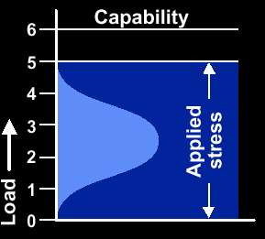
Describiendo Funciones y
Estándares de Desempeño
• Estándares de desempeño múltiples
• Cuantificando estándares de desempeño
• Estándares cualitativos
• Estándares absolutos
Poder
Querer
• Estándares de desempeño variables
Si un activo está sometido normalmente a un amplio rango de esfuerzos, el esfuerzo más severo debe ser incluido como el desempeño deseado

Slide 32
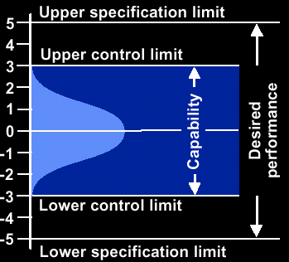
Describiendo Funciones y
Estándares de Desempeño
• Estándares de desempeño múltiples
• Cuantificando estándares de desempeño
• Estándares cualitativos
• Estándares absolutos
• Expectativas de desempeño variables
Desea
Puede
Puede
• Límites Superiores e Inferiores:
250 ± 5 gm, 75 ± 0.1 mm
Desea
Funciones
Notes:
More complex, if i have a packing operation, impossible to develop a machine that will pack exactly 250 g. this is what spc recognizes. +-5 required --- machine capable of +-3. We're connecting SPC with RCM. ucl = capability, usl = desired performance. Out of control versus out of spec - will talk about later.

Slide 33
Funciones de Protección
Hay cinco tipos principales de dispositivos de protección
(puede dar por lo menos dos ejemplos de cada uno?):
• Avisar al operador acerca de condiciones anormales.
• Apagar al equipo cuando se presente una falla.
• Eliminar o suavizar las condiciones anormales causadas por la falla.
• Asumir la función que ha fallado.
• Prevenir que crezca una situación de peligro.
Funciones
Notes:
Protection, fifi and her mother. First step into a swamp when we ask about protection. (don't say this on a 3 day course)
Look at page (not normally done on a 3-day course) 172. All hidden functions are protective devices. Not all protective devices are hidden functions.
Fewer than 1/3 of protective devices receive any attention at all. 2nd third consciously don't. No one even knows that the final third exists. And the first third are maintained poorly.
Why this is so: HAZOP. A lot of similarities with RCM. Identifies hazards. Identifies functions (much more crudely). Identifies failed states - less precisely than we do. Identifies cause. Normally ends up by adding a protective device. Does not ask question "Can protective device fail?" Hence they (protective devices) are breeding by the 10s of
thousands. Most disturbing aspect of modern PAM.
People forget that the device is there or what it's for. (Pump C is a protective device.)
Issue for top management. Competitor – “treat whole system as non-critical if it has protective devices.”
warning devices: alarms, lights (not control indicators)
shutdown - trip switches, circuit breakers
eliminate, relieve abnormal condiiton caused by failure - safety valve,
sprinkler (eliminates the fire not the failure)
take over - any form of standby plant, redundant structural
components.
prevent dangerous situations from arising - warning signs or guards.
so protection includes a lot of stuff. That's why the subject is very complex.
Warning signs are hidden functions! If it's gone you don't know about it. Example, Lift "don't use elevator in case of fire". if sign is not there, it's hidden. No one knows it’s missing.
Therefore should have list of all warning signs in plant. 1. keep it up to date. 2. check if their still there or legible. airlines do that, military too. This makes people start thinking.
You must establish what it is and what it does.

Slide 34
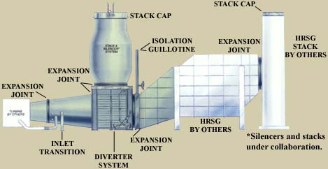
Especificando las Funciones
Funciones

Slide 35
Especificando las Funciones
Funciones
Notes:
shows all the performance standards in red (caps).
Why we chose this example... It is often said that RCM no good for
electrical or civil stuff. The whole thing (the exhaust pipe) is an
inert structure. We should mention this point.

Slide 36
Preguntas 2, 3, y 4
2. Fallas Funcional
3. Modos de falla
4. Efectos de las fallas

Slide 37
Que problema hay en decir folló la bomba???
Capacidad Inicial
Capacidad Nominal
de la Bomba A:
1,000 litros por
minuto
A
Entrega =
800 lt/min.
Desempeño deseado
Notes:
Adequate margin for deterioration. (reminding people of the stuff
before lunch. We're going through this very quickly.)

Slide 38
Especificando las Fallas Funcionales
De qué manera el activo falla en cumplir con los requerimientos del usuario, el dueño o la sociedad.
• Estados de Falla
• Definiendo Fallas Funcionales
• Cómo deben ser registradas las Fallas Funcionales ?
Fallas
Notes:
very quickly

Slide 39
Fallas Funcionales
Lo que puede hacer el activo
“Puede”
ESTADO GENERAL
DE FALLA
“Desea”
(lo que el usuario desea
que haga)
Lo que deseamos que haga está por fuera del alcance de lo que puede hacer
Desempeño
Notes:
bring back "Desired Performance"

Slide 40
1
2
3
“PUEDE”
“PUEDE”
“DESEA”
“DESEA”
Desempeño
“DESEA”
“PUEDE”
Desempeño
Lo que el usuario
“desea” aumenta por encima de lo que “puede”, después de que entra en servicio
Lo que el usuario
“desea” está por encima de lo que “puede”, una vez que entra en servicio
"Puede" caer por debajo de lo que se “desea“, después de que entra en servicio
Prevenga este estado poniendo energía en el sistema que mantiene el poder por encima del desear ... Esta energía es llamada mantenimiento
Para salir de este estado:
• Modifique de tal manera que se pueda hacer lo que se desea, o
• Disminuya lo que el usuario desea que haga.
Evite este estado haciendo un mejor trabajo de emparejar lo que “desea”con lo que “puede”en las etapas de diseño, compras, o por medio de una instalación más cuidadosa
Las Fallas: tres tipos
Notes:
Reason 2: demand has risen. sustained deliberate overloading. We know
we're hammering the plant into the ground and failure rate increases
dramatically.
Tampax - packs 85/min standard throughout world. A VP decides they can
go faster. Very reliable up to now. They can actually run at 105. Wow
20% increase - that's what happened for a few months. Then availabiliy
fell to 70% he did enormous damage. They had to wind it back to 95 and
pay $millions for repairs to damage.
Conclusion they don't understand this model: [show flipchart L12 "Desired
Performance]
Reason 3. Sustained unintentional overloading. Back to fpchrt "freeze
dryers" (R11). Generally happens with the compressed air. Keep slapping
new things into the air line. (you see portable compressors all over
the place)
Next one Sudden intentional overloading. Accident (freak will never
happen again - people will pay a fortune to avoid.)
Incorrect process or packaging materials. Paper thicker. what do we do
? Maintenance? modify
3. Outside envelop from start What do we do? Better job of matching can
to want.
Q: Whose responsibility is reliability?
maintainers , operators, designers
[Words you should not mention (early) on 3-day course: facilitator.
review groups. But what am I doing with slides like this. I'm starting
to make the case for it. Remember we stopped at slide 30 on first day.
Help people discover for themselves the need for it. Rather than usual
reaction: "Oh Oh here is another HR touchy feely bullshit type course."
And they start quitting. So we take great care to play down that issue
in the early part of the three day course. ]
So in this slide we're making yet another case for facilitators.[??]

Slide 41
Falla Total vs Falla Parcial
Capacidad inicial del activo
A
”PUEDE" = 400 l/min
”DESEA" = 300 l/min
400 litros/
minuto
Lo que los usuarios desean
Desempeño
OK✓
300
litros/
minuto
Notes:
[Slide 5 -7]
RCM recognizes difference between totally and partially failed state
Totally failed - cannot pump at all. (TPM also makes a big deal of this.)
Q: Why do we make distinction (between total and partial failure)?
A: Because the modes are different.

Slide 42
Falla Total vs Falla Parcial
A
”PUEDE" = 400 l/min
”DESEA" = 300 l/min
0 litros/
minuto
Desempeño
Falla Total×
300
litros/
minuto

Slide 43
Falla Total vs Falla Parcial
A
”PUEDE" = 400 l/min
”DESEA" = 300 l/min
280 litros/
minuto
Desempeño
Aún trabaja, pero la capacidad está por debajo de lo que el usuario acepta
Falla Parcial×
300
litros/
minuto

Slide 44
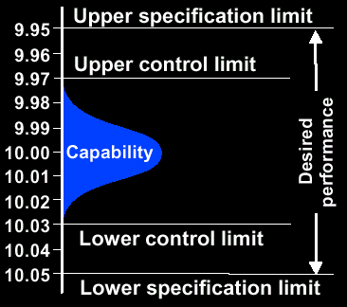
Límites Superior e Inferior
Fallas
OK
(La diferencia entre los
límites de especificación
deberían ser entre 1.5 y 2 veces la diferencia inicial entre los límites de control )
OK✓
Notes:
Explore in more detail
a well specified 1 - 1.6 x
Fails when it is out of spec not when it is out of control. You might
end up with someone who argues with you. You will get op or first line
supervisor. I am told to stop the process when I start drifting out of
control. That's a policy. You are "failing". We are not "failed". [we
were furiously agreeing. Small point but watch out for it].

Slide 45
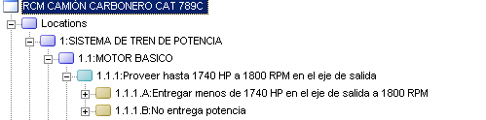
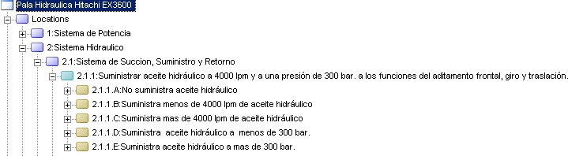
Especificando las Fallas Funcionales
Notes:
very quickly

Slide 46
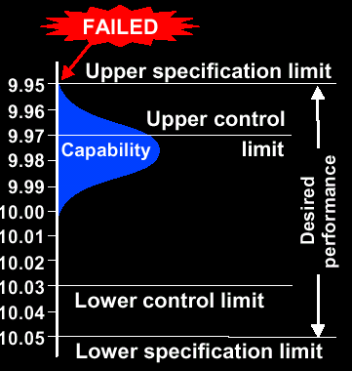
Límites Superior e Inferior
Fallas
Fuera de especificación
solamente en una dirección
Desea
Puede
Puede
Desea
Notes:
Out of calibration. Wind blowing bullet off course. Consistent but in
wrong place. For example, milling cutter worn.

Slide 47
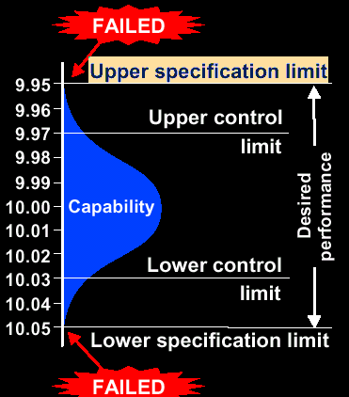
Límites Superior e Inferior
Fallas
Fuera de especificación en ambos sentidos
Desea
Puede
Puede
Desea
Notes:
Out of spec both ways. Gets really sloppy. Out of spec both ways.
Filler in beer industry. Looseness. Tighten it all up.
Shooting all over the target. Drunk. Barrel worn.
Applies to any system that requres precision and accuracy of any sort.

Slide 48
La función primaria de una caja de engranajes es “Transferir potencia”. Una función secundaria es “contener el aceite"
OK
Analista de Seguridad
Unas pocas gotas en el piso
Límite de Mantenimiento
1 litro/minuto
Desempeño
Límite de Producción
galones/min
Pegado
• El Gerente de Mantenimiento dice que esta función ha fallado cuando la fuga ocasiona excesivo consumo de aceite.
• El Analista de Seguridad dice que ha fallado cuando una fuga origina charcos de aceite en el piso.
• El Gerente de Producción dice que ha fallado cuando la fuga es tan grande que la caja de engranajes se funde.
Quién tiene la razón?
Notes:
Who's right?
99% of your delegates will say they're all right.
so what's he fussing about
Draw pf curve (but don't identify it as such) on flpchrt 1
[flpchrt L16_________________________________________________
--------------------------------- ok
x
xxxxxxxxxxxxxxxxxxxxxxxxxxxxxxxxx safety officer
................................. maint limit 90 l/mo
x m/c not released for PM
--------------------------------- can pour in buckets of oil
--------------------------------- Seized
___________________________________________________________
Prod manager will completely accept pouring in buckets of oil.
Unfortunately maint mgr can't afford to pour in buckets of oil.
so hi limit is "x" liters per month
they never talk to each other
Lube man says boss we're at 95 liters/mo
Now let's watch one of the most common scenarios in maintenance
management...
Mechanic or planner goes to production. Asks for availability. Prod mgr
says go away. He writes in his little black book "Machine not released
for PM" (anybody seen this?)
What is he implying? That prod guy doesn't agree with PM.
Is that true?
Of course he does.
He just has a different standard.
Somebody else has a view on this - our safety officer.
He says a liter is the limit. He went to a TPM course which says a
little trickle foretells a big problem.
He goes to maint mgr who tells him to go away.
Now we have the other big reason "No Labour".
Do we have " no labour".
Of course we have plenty of labor.
What must we do?
Answer: We all must agree on what we mean by "failed".
Every time I hear either of these sob stories, you will always find
that this is the fundamental problem.
This is the "Roman messenger" syndrome.
This is a very powerful message.
We didn't define a performance standard for "Contain oil". Needed to
define a loss rate.
This gives them serious food for thought.

Slide 49
Definiendo Fallas Funcionales
Fallas
Los estándares de desempeño usados para definir las fallas funcionales deben ser definidos en conjunto, entre el personal de Producción y de Mantenimiento, y alguien más que esté relacionado con el desempeño del activo y que tenga algo legítimo que decir

Slide 50
Cómo Deben Registrarse las Fallas Funcionales ?
Fallas
Notes:
illustrating that the functional failures always relate to the
performance standards. Match of the reds on both sides.

Slide 51
RCM
Modos de Falla
Notes:
do small recap
any questions?
Don't get sucked into a big debate about stuff you will be talking
about in a half hour.

Slide 52
Modo de Falla
• Cuál fue la causa de la falla?
• Cuáles modos de falla deben ser listados ?
• Describiendo Modos de Falla
• Cómo deben registrarse los Modos de Falla
Notes:
Now we get into failure modes
how to describe
how to record
Q: What is a failure mode?
Be very careful:
in general world has two separate and distinct meaning.
Lies behind a lot of confusion.
We define a func fail as a failed state
and a failure mode is an event that causes the failed state.
Failed state = dead . does not describe cause
Failure mode= could by anything. The event.
Why am I hammering this?
The other technologies are less precise than this.
Be warned.
Neither party is wrong. Don't get into this in 3-day course. But you
may encounter delegates with a MIL STD.1629A background.

Slide 53
Modo de Falla
Qué es un Modo de Falla?
• Un modo de falla es un evento que origina un estado de falla (una falla funcional)
• La descripción de un modo de falla debe consistir de
  Un sujeto (“filtro”), y
  Una acción (“tapado”), y
  Una causa (opcional) “por …, debido a..”
Notes:
What is a failure mode?
I have seen sheets likd this
FF FMode FCause Fmech
dead heart bullet someone
stopped passed pulled
thru trigger
with three columns what is he implying
that there are two-three levels of causation.
and are their only 3 levels of causation?
No.
How many?
infinite
In our world
Failure mode = Failure cause = Failure mechanism
Other people would disagree.
How we handle this question of drilling down - we will spend a lot of
time on that.
We subscribe to the school of thought that it is the event that causes
the failed state.
Failure mode = noun and verb (could be passive form of verb)
[Flpchrt R21]_______________________________________________________
key sheared
power fails
shaft shears
bearing seizes ---------------> misaligned,
impeller falls off lube failure--------->No grease
inlet blocked by f.o. normal w&t Wrong grease----,
v/v closed disintegrated Dirty grease |
motor burns out Too much |
protection (nuisance) trips |
| -distracted<-----------'
| -no stock
| -sabotage
v -wrong label
____________________________________________________________________
What would be a deeper cause of lube failure?
wrong grease, dirty grease, too much grease, ad infinitum
Why wrong grease?
greaser distracted, no stock of proper grease, wrong label on drum
Why was he distracted?
Another decision that we have to make - how much detail is needed?
If we stop too soon we end up with a superficial and possibly dangerous
analysis.
If we go to far --> analysis paralysis

Slide 54
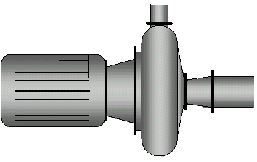
Modo de falla
Un modo de falla es un evento que origina un estado de falla
La descripción de un modo de falla debe consistir de un sujeto y un verbo ("filtro tapado”)
Para esta bomba, qué modo de falla pudo causar la falla funcional: “incapaz de bombear totalmente ”?

Slide 55
Cuando se Listen Modos de Falla...
Potencia de suministro cortada
Impulsor roto
Carcaza rota
Sello de la bomba fallado
Rodamientos del motor pegados
Motor conectado invertido
Estator con devanados quemados
Eje roto
Cuña del eje de mando rota
Válvula de entrada pegada en posición cerrada
Válvula de entrada cerrada
Bomba no arranca
Engranaje de mando en falla
Cables de potencia fallados
Qué tan profundo vamos?
Pocos modos de falla y/o insuficiente profundidad conduce a decisiones de mantenimiento superficiales y peligrosas.
Demasiados modos de falla y/o demasiada profundidad conducen a parálisis por análisis.
Cuántos?
Notes:
we could spend the rest of the night discussing this.
pump hit by meteor is actually true.
portugal - new failure mode, shoot kiln, missed, hit conveyor. Context
specific.
Two reasons analysis can take too long:
1. going too low
2. too much detail
facilitator needs to be skilled to manage this.
Where do we stop?
Only failure modes that are reasonably likely (credible) in the
operating context. credible as opposed to incredible.
failure modes that have occured in a similar equipment in similar context
failure modes addressed by existing PM programs
failure modes not being addressed but thought to be likely.
Be realistic. No prize for the longest list.
One influence is the consequences as to how defensive you need to be.
more defensive = longer list
Very very much a judgment call arrived at through consensus.
The other dimension -- How much detail. "5 why" very popular in U.S.
When we go 1 level down we're asking why once. One methodolgy says ask
"why" 5 times. Then you'll be there. Some otherwise quite serious adults
have fallen into this. More detail <---> less detail. Will get there
eventually God or the big Bang. 5 times is preposterous, unbelievably
simplistic.
Where should we stop? - where we have a reasonable chance of being able
to do something. [Distracted - keep an eye out for obviously spaced out
people]. One step higher - can we do something to make it impossible to
use the wrong grease? One step higher - perhaps vib analysis. Important
point: Sometimes it's appropriate to go to less detail. The point at
which we we stop - where it is possible to identify an appropriate
failure management policy. Bearing seizes: unless I happen to know that
80% of my bearing failures are due to grease problems.
Turn your attention to three important pages of new version of book 66 -
68. More detailed version of this slide. I have put 7 levels. why?
more than 5 (to reinforce the arbitrariness of 5). People are adament
on the number 5. We say in some cases it's appropriate to ask why only
*once*. Example hidden failure - pump c. Only need to ask "why" once.
But in pump A we might have gone to level 7.
Important point: don't have to identify failure modes at the same level.
Some are blank. What conclusion do we draw? We need to identify the
appropriate level. It's a skill of the facilitator. The more analyses
you do the easier and more intuitive this becomes. You have to be
thinking ahead somewhat - to the consequences. Might ask - is there a
particular common reason why pump set fails on stand-by. If someone
says we get serious risk of brinelling, then need to go one step
further. Still only requires one column on info worksheet. When
challenged say "we're aware of all this - but it's just too time
consuming and not necessary." [??]
Summarizing
The two questions:
1. how much detail?
2. where to stop?
In other words need to avoid being either: Too deterministic, not
determinsitic enough The key is practice!
These are part of the 45 skills. A facilitator never asks: "Have we
gone into enough detail?" Otherwise he is saying he doesn't know and
it's a subject for debate. Controlled by how he asks the question. You
have to screw up a few times to get the knack. Seldom an issue for a
good facilitator!
[Last point - competitive - not for 3-day consumption. Failure Modes
given as a pull down menu for this type of equipment. Claim to save
your time - a hell of a lot of time. Not valid - too easy to fall into
trap of power of suggestion. Don't do it. Pull down list makes a
certain assumption: Everything is at a given level. Decision has been
made that all are at same level, But the level is context specific.
Caveat - such lists will eventually be useful as more people understand
the application of levels of "why". Like a generic set of accounts. But
no software product is there yet. Second important point - List might
give an idea but there is a pressing need to make an informed decision.
Learn how to do FMEA yourself. Lists could be an excuse not to think -
can be dangerous.]

Slide 56
Modos de falla
Qué tanto?
Menos profundidad
Más profundidad
Potencia de suministro cortada
Impulsor roto
Carcaza rota
Sello de la bomba fallado
Rodamientos del motor pegados
Motor conectado invertido
Estator con devanados quemados
Eje roto
Cuña del eje de mando rota
Válvula de entrada pegada cerrada
Válvula de entrada cerrada
Bomba no arranca
Trabajo intermitente
Engranaje de mando en falla
Cables de potencia fallados
Bomba falla
Desgaste normal
Carga axial alta
Mala instalación
Falla de Lubricación
Motor falla
Conjunto de la bomba falla
Mando falla
Aceite base oxidado
Aditivos agotados
Ingreso de agua
Sello rodamiento falla
Grasa inadecuada
Válvula falla
Potencia falla

Slide 57
Cuántos?
Potencia de suministro cortada
Impulsor roto
Carcaza rota
Sello de la bomba fallado
Rodamientos del motor pegados
Motor conectado invertido
Estator con devanados quemados
Eje roto
Cuña del eje de mando rota
Válvula de entrada pegada cerrada
Válvula de entrada cerrada
Bomba no arranca
Trabajo intermitente
Engranaje de mando en falla
Cables de potencia fallados
•
Bomba saqueada?
Bomba golpeada por un meteoro?
En la práctica, solamente deben listarse modos de falla que son razonablemente probables (“creibles”) en el contexto operacional
Esto incluye modos de falla que:
Ya han ocurrido en el equipo o en otro similar
Están siendo prevenidas por el programa de mantenimiento actual
No han ocurrido pero que tienen altas posibilidades de ocurrir.
Fallas causadas por errores humanos (operador / mantenedor / reconstrucción / fabricante).
Si las consecuencias son muy serias, entonces modos de falla con menos probabilidad de ocurrencia también deben listarse.

Slide 58
Acerca de los modos de falla………
Modos de falla
Deben describirse en suficiente detalle para que sea posible seleccionar una política de administración de falla conveniente, recuerde que muy poco detalle lleva a análisis superficiales y excesivo detalle hace demasiado extenso el ejercicio.
Debe apuntarse hacia las CAUSAS y no a los síntomas o las consecuencias de la falla.
Según la complejidad de un elemento y el nivel en que se analice, puede hacerse una lista de entre uno y treinta modos de falla para cada falla funcional.
Tampoco se debe olvidar que el contexto en que opera un activo influencia los modos de falla a considerar, desde el punto de vista de causa, probabilidad y consecuencias.

Slide 59
Modos de Falla
Debido a … (“causa” en EVENT)
• Deterioro (evaporación, erosión, fatiga, abrasión, corrosión, etc). Desgaste Normal “Dientes de ripper desgastados”
• Falla de Lubricación (falta de lubricante o el lubricante falla)
  Caja de engranajes pegada por falta de aceite.
• Acumulación de suciedad
  “Drenaje bloqueado por acumulación de barro”, “Corto circuito por acumulación de polvo entre los terminales”, “ Señal de peligro obstruida por suciedad acumulada”.
• Procesamiento o material de empaque inadecuados
  “Nivel de humedad en la mezcla demasiado alta” “Papel de empaque demasiado delgado”
• Ensamblaje incorrecto
  “Válvula instalada al revés”, “Fusible de tamaño incorrecto”, “Eje desalineado.”
• Ajuste incorrecto
  “Cuchilla de corte demasiado profunda”, “Interruptor de vibración ajustado demasiado alto.”
• Operación incorrecta
  “Palanca de retroceso seleccionada mientras se desplazaba hacia adelante”
No importante en RCM
Quién?
Notes:
Gearbox bust. Light fucked. If you write failed - you are actually
black boxing.
At the end of each session. Hand out the notes relevent to that session:
intro function modes consequences etc.
French book - helvetica stuff dropped from notes. Otherwise follows the
chapter of the book. Huge competitive advantage. Large multinational
corporations starting to understand that they will get exactly the same
course in their various divisions. Alsthom, Exxon mandating RCM2
worldwide. Big part of Aladon's budget goes into this translation work.
Done under the guidance of practitioners. So we think it's technically
consistent.
[CHECKPOINT - FAILURE CONSEQUENCES 11:15 DAY 2]

Slide 60
Equipos idénticos pueden tener modos de falla diferentes si el contexto operacional es diferente...
Servicio
Stand-by
B
C
• Rodamientos pegados
• Impelente trabado por objeto extraño
• Línea de succión tapada por suciedad
• Tornillos de acople partidos por fatiga
• Sin energía
• etc
• Rodamientos picados
• Línea de succión tapada por suciedad
• Componente clave “prestado” por emergencia
• Grasa acumulada en los rodamientos
• Sin energia
• etc
Notes:
brinelling - dangers of too much generic thinking.

Slide 61
Un modo de falla es un evento que origina un estado de falla.
La descripción de un modo de falla debe consistir de un sujeto y una acción ("filtro tapado”) y una causa (opcional).
Notes:
[break for supper]
Back to exercise Do each functional failure completely before going to
next one. Not that big a deal to figure out the appropriate level.
Study it. There is a reason that we hand this out now.

Slide 62
Efectos de Falla
La descripción de los efectos de las fallas deben permitir evaluar las consecuencias de las fallas.
Qué se debe describir ?
  Cómo se manifiesta la falla por si misma.
  Cómo se impacta la producción (calidad, costo, servicio al cliente).
  • Qué secuencia de eventos (internamente y a lo ancho de la organización) podrían ser afectados por el modo de falla.
  • Cómo se afecta la seguridad o el medio ambiente (sin mencionar las palabras "seguridad" o “ambiente").
  • Hay algún daño adicional causado por la falla.
  • Cuánto tiempo se tomará y qué acciones se requerirán para corregir la falla.
  • Ha pasado antes y bajo qué circunstancias. Qué se ha hecho normalmente para mitigar las consecuencias de este modo de falla.
  • Cuál es el estado de las partes que se cambiaron?

Slide 63
Efectos de la Falla
Qué se debe asumir cuando se listan los efectos de las fallas ?
Los efectos de las fallas deben describirse como si no se estuviera haciendo nada para prevenirlos. *
* Pero puede incluir una descripción de lo que se está haciendo para prevenir o reducir las consecuencias de la falla.
Notes:
Passenger train in Hong Kong
[flpchrt L20]_______________________________________________________
______________________
/| | | |\
| |__|______________________|__| |
| | |______X_______________| | |
\| |/
breaks
FM V FE
Member -cracks- due to fatigue Crack would be detected in workshop and
repaired. Trains 0-0-S for 2 days.
____________________________________________________________________
Misleading. They evaluated as operational consequences not safety
consequences. Went down the wrong column. What should have been written
was what? What was the first mistake?
The failed state is not cracks but broken. When is it likely to break?
When it's full of passengers going round a corner.
"cracks" is the failing state not the failed state. Misleads. You have to
assume that it goes all the way to the failed state. 0 basing - as if
you're doing nothing.
What is the difference between a failure effect and a failure
consequence? HAZOP has it in the same column. British standard defn. A
failure effect is a failure consequence. Distinction is very clear.
Right there in those 7 questions. Effect = what happens Consequence =
does it matter. Effect: Is there noise, does it stop, is there a smell,
does a light come on, does surge bin level drop until there is an alarm.
[Later on you ask if it is evident to operators.] How could it affect
safety or environment? You don't write the word "safety". If you do
you're actyakkt beginning to assess consequences. Rather say, "This
could release toxic fumes of 55 ppm into the atmosphere". How does it
affect production?
[flpchrt L21]_______________________________________________________
STOP | | | | | |START
FIND| FIND | FIND |FIND|FIX |TEST |
MAN | FAULT| ELECTRICIAN |PART|IT |IT |
<-2H->
<---------------5 HOURS---------------------->
DOWNTIME
____________________________________________________________________
What's important? The production log sheets. We don't want MTTR, we want
d/t (down time). Late at night. Finally we have them all lined up.
maint report you see 2h mttr. What counts is
mean-time-to-return-to-service not mean-time-to-repair.
Let's look at the meaning of "mean" in MTTR. 12-24 hours. Mean is 18
hours. If I base my analysis on an assessment of 18 hours, I'll be
wrong half the time. Use typical worst case I would take 22 hours.
TWCDT (typical worst case downtime). Real world business oriented
consequence assessment.
Does it cause any secondary damage? What must be done to repair it?
(usually mentioned together)
These 5 bullet points need to be considered [next slide]

Slide 64
Efectos de la Falla
Aclaración………..
Nótese que efectos de falla no son lo mismo que las consecuencias de la falla, un efecto de falla responde la pregunta “Que ocurre” mientras que una consecuencia de falla responde a la pregunta “Que tanto importa?”.

Slide 65
Efectos de la Falla
Descripción de los eventos
  Evidencia de Falla. Se deben describir de tal forma que el equipo RCM pueda decidir si la falla será o no evidente al operador en circunstancias normales.
  Debe establecer si la falla está acompañada (o precedida) por efectos físicos obvios como ruidos, fuego, humo, escape de vapor, olores o derrames de líquidos en el piso. Además debe establecerse si la máquina se apaga como resultado de la falla.
  Debe incluir detalle sobre la posibilidad de que alguien salga lesionado o muerto como resultado directo de la falla, o que se pueda violar alguna reglamentación ambiental;por ejemplo:
    Incremento en el riesgo de fuego o explosiones
    Escape de químicos riesgosos
    Electrocución
    Colapso de estructuras, etc.

Slide 66
Efectos de la Falla
Descripción de los eventos (Cont.)
  Estas descripciones deben ayudar también a la toma de decisiones sobre consecuencias operacionales y no-operacionales, para esto deben indicar cómo se afecta la producción (si es afectada) y por cuanto tiempo. Considere siempre el “típico peor de los casos”.
  Incluir detalle sobre la forma en que se afecta la calidad del producto o el servicio al cliente, si otras actividades deben detenerse o hacerse más lentamente, si se origina un daño secundario adicional.
  La descripción de estos efectos debe incluir lo que debe realizarse para reparar la falla y el tiempo down que ello implica.

Slide 67
Efectos de la Falla
Ejemplo, consideremos un elemento que podría detenerse totalmente como consecuencia de la falla de una caja de engranajes pequeña.

Slide 68
Efectos de la Falla
Fuentes de Información sobre Modos y Efectos.
  El fabricante o vendedor del equipo. Aunque tiene limitaciones bastante obvias, la mejor forma de aprovechar su participación es con un técnico de campo en el equipo RCM.
  Listas genéricas de modos de falla. Se pueden utilizar con precaución, sólo para complementar un FMEA desarrollado.
  Otros usuarios del mismo equipo. Cuando esto es posible.
  Historiales de mantenimiento. También como información complementaria.
  La gente que opera y mantiene el equipo. De lejos es la mejor fuente de información para preparar un FMEA. Ellos deben hacer parte del ejercicio formal de RCM.
Registro en Hoja de trabajo

Slide 69
Efectos de Falla - Pala Hidráulica
Comentarios
Qué encontré
Qué hice
Agregue detalles
si es necesario
Agregue detalles
MODO DE FALLA | EFECTOS DE LA FALLA
Acople del motor diesel y caja de bombas partido por sobre carga | El motor diesel aunque continua operando no hay transmisión de movimiento hacia la caja de bombas, por ende no hay suministro de aceite hidráulico, no hay ningún movimiento de actuadores. El equipo queda Down. Se activa la alarma de baja presión de aceite de la caja de bombas en el panel de control. Si el motor continua encendido puede llegar a recalentarse, por que los ventiladores del sistema de refrigeración se detienen, la alarma de alta temperatura de refrigerante en 100 C apaga el motor. Cambiar el acople y colocar en funcionamiento demora 48 horas.

Slide 70
Consecuencias de las Fallas
    Consecuencias de fallas ocultas
    Consecuencias en seguridad y medio ambiente
    Consecuencias operacionales
    Consecuencias no operacionales

Slide 71
CONSECUENCIAS DE LAS FALLAS
Cada vez que ocurre una falla la organización se afecta de alguna manera, pero en cada. caso los efectos son diferentes, ellas pueden afectar la calidad del producto, el servicio al cliente, la seguridad, el medio ambiente y la reparación de la falla se toma algún tiempo y tiene algún costo
Las consecuencias de las fallas son más importantes que sus características técnicas.
En general, la idea del mantenimiento proactivo no es prevenir la ocurrencia de la falla per sé sino el evitar o reducir las consecuencias de la misma.
Para una clasificación de las consecuencias se deben primero definir las funciones como evidentes y ocultas:
  Una función evidente es aquella cuya falla será, por si misma, eventual e inevitablemente evidente al operador bajo circunstancias normales.
  Una función oculta es aquella cuya falla no se hará evidente al operador bajo circunstancias normales, si ocurre por si misma.

Slide 72
CONSECUENCIAS DE LAS FALLAS
CLASIFICACION
RCM clasifica las consecuencias de las fallas en cuatro grupos:
    Consecuencias de fallas ocultas: Fallas ocultas son aquellas que no tienen un impacto directo, pero exponen al equipo a una FALLA MULTIPLE con consecuencias serias y a menudo catastróficas.( la mayoría de estas fallas están asociadas con los dispositivos de protección)
    Consecuencias en seguridad y medio ambiente: Una falla tiene consecuencias en seguridad si puede herir o matar a alguien y tiene consecuencias ambientales si viola alguna norma local, regional, nacional o mundial sobre el medio ambiente.

Slide 73
CONSECUENCIAS DE LAS FALLAS
Clases de consecuencias en RCM (Cont.)
    Consecuencias operacionales: Una falla tiene consecuencias operacionales, si afecta la producción (productividad, calidad del producto, costos de operación, servicio al cliente,..)
    Consecuencias no operacionales:Son fallas evidentes que no afectan la seguridad ni la producción y el único costo directo es el de su reparación.
Sin embargo, antes de cualquier consideración de consecuencias el RCM reconoce la existencia de fallas que no tienen consecuencia aparente alguna cuando suceden independientemente. Reconoce que es preciso tratar estos casos especiales individualmente. Son las llamadas fallas ocultas.

Slide 74
FALLAS OCULTAS
Una función oculta es aquella cuya falla no es detectable por los operarios bajo circunstancias normales, si se produce por sí sola.
La única consecuencia de una falla oculta es un riesgo mayor a que ocurra una falla múltiple.
El esfuerzo que se ha de realizar para evitar una falla oculta dependerá de las consecuencias de la falla múltiple.
Ejemplos:
  La falla de una bomba redundante en un sistema.
  El bombillo de una alarma luminosa en un tablero de control.
Ejercicios

Slide 75
LOS SIETE (7) PASOS
PARA EL PROCESO RCM

Slide 76
FMEA

Slide 77
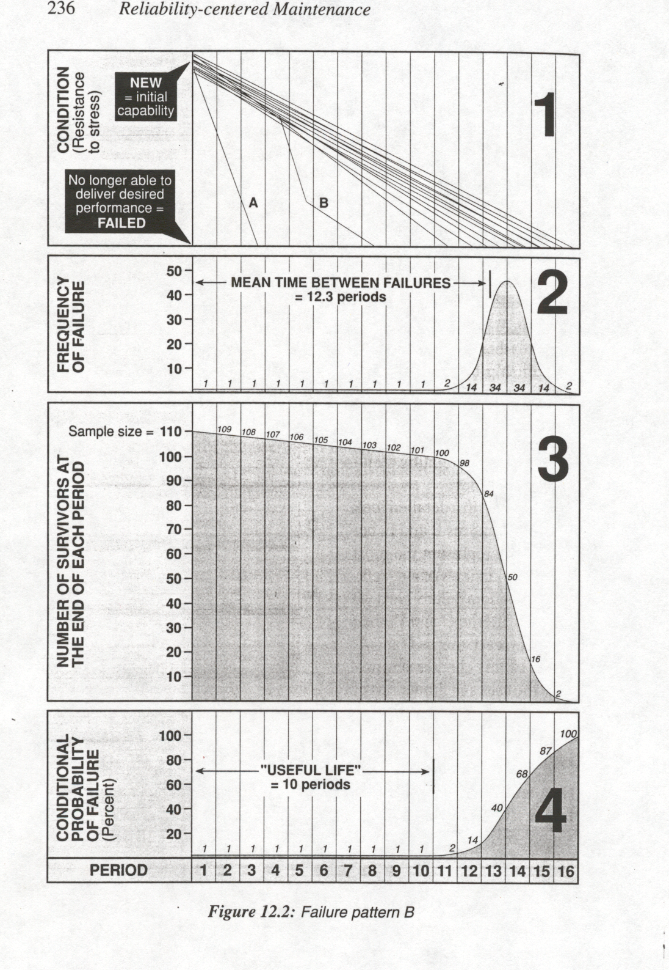
COMPORTAMIENTO DE LAS FALLAS

Slide 78
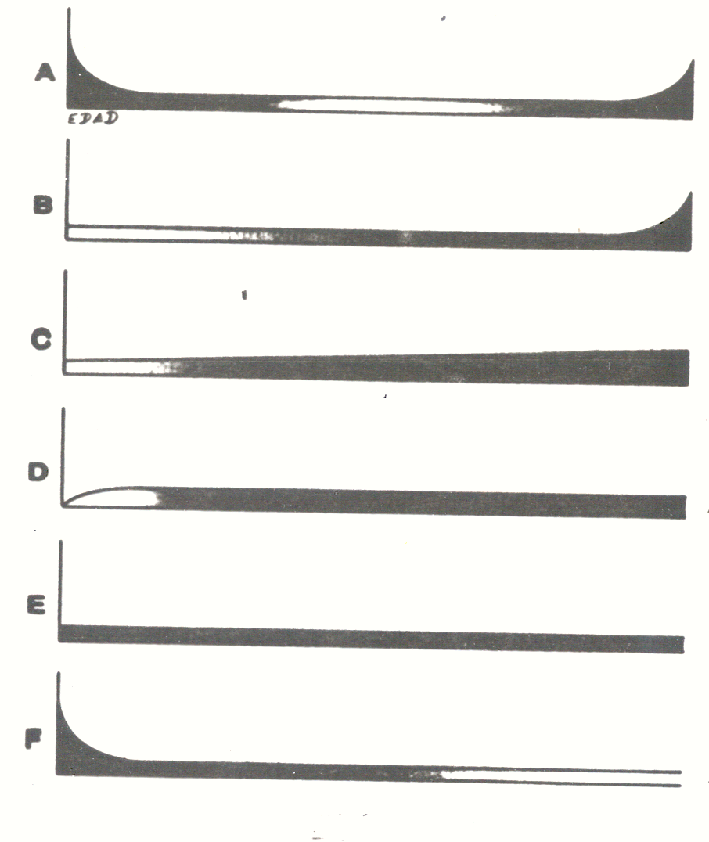
PATRONES DE FALLAS
BATHTUB 4%
TRADIC. 2%
INCREMEN. 5%
INC. PRONUN. 7%
RANDOM 14%
“J”INVERTI-
DA 68%

Slide 79
PATRONES DE FALLAS

Slide 80
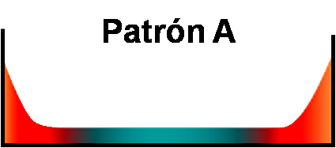
PATRONES DE FALLAS
“La curva de la bañera”; Alta mortalidad infantil seguida de un bajo nivel de fallas aleatorias, terminando en una zona de desgaste.
Análisis de fallas para determinar las causas de las fallas infantiles
Monitoreo de la condición
Reemplazo o reparación basada en el tiempo.

Slide 81
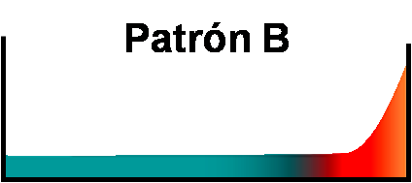
PATRONES DE FALLAS
“El punto de vista tradicional”; Pocas fallas aleatorias terminando en una zona de desgaste
Reemplazo o reparación basados en el tiempo.
Análisis de fallas si el desgaste está ocurriendo antes de lo estimado o requerido.

Slide 82

PATRONES DE FALLAS
Constante incremento en la probabilidad de falla.
Reemplazo o reparación basado en el tiempo en función del costo o riesgo

Slide 83

PATRONES DE FALLAS
Un rápido incremento en la probabilidad de la falla seguido de un comportamiento aleatorio.
Monitoreo de la condición.
Análisis de fallas si la tasa de falla es muy elevada.
Provisión de repuestos.

Slide 84

PATRONES DE FALLAS
Fallas aleatorias, ninguna relación entre la edad de los equipos y la probabilidad de que fallen.
Monitoreo de la condición
Operar hasta fallar.
Análisis de fallas si la tasa de fallas es más alta que la deseada o requerida.
Provisión de repuestos.

Slide 85
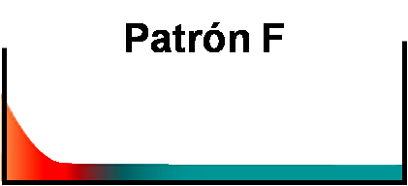
PATRONES DE FALLAS
Alta mortalidad infantil seguida de un comportamiento aleatorio de la probabilidad de fallas.
Análisis de fallas para determinar las causas de las fallas infantiles.
Provisión de repuestos.
No implementar mantenimiento basado en el tiempo.

Slide 86
PATRONES DE FALLAS
Corresponden a elementos simples ó equipos complejos en los cuales las fallas tienen una causa dominante.
Asociados normalmente con elementos de los equipos que están en contacto directo con el producto.
Fatiga
Corrosión
Evaporación
Abrasión

Slide 87
PATRONES DE FALLAS
Asociados con equipos complejos de electrónica, hidráulica y neumática.
(Prácticamente todos los rodamientos siguen el patrón E)

Slide 88

PATRONES DE FALLAS Y LAS ESTRATEGIAS
TIPOS DE FALLAS
Patrón A
Patrón D
Patrón B
CÍCLICAS
ALEATORIAS
Patrón E
Patrón C
Patrón F
Agonía
SÚBITAS O REPENTINAS
PROGRESIVAS
Notes:
88

Slide 89
SELECCION DE LAS TAREAS
Tareas Proactivas: Son las tareas que se realizan para evitar que el equipo falle o minimizar las consecuencias de la falla (Mantenimiento Predictivo + Preventivo)
Mantenimiento a Condición:
  Monitoreo de condición (Vibraciones, Termografía, UT,.)
  Monitoreo de Efectos primarios (Flujo, temperatura, presión,..)
  Monitoreo de la variación de la calidad del producto (algunos defectos en el producto están relacionados con algunos defectos en la máquina y éstos comienzan gradualmente lo que hace que se detecte la falla potencial)
  Los Sentidos Humanos (Mirar, oír, tocar y oler)
Tareas de sustitución cíclica y de reacondicionamiento cíclico
  Si no se puede encontrar una tarea de monitoreo de condición, la opción siguiente es la del cambio cíclico si es técnicamente factible y costo efectiva

Slide 90
SELECCION DE LAS TAREAS
Acciones “A falta de...” (Default Actions)
  Tareas de búsqueda de fallas
  Una tarea programada de búsqueda de fallas asegura la verificación de una función oculta a intervalos regulares para ver si esta ha fallado.
  Ningún Mantenimiento preventivo (RTF – Run to Failure)
  Cuando no se ha encontrado una tarea programada adecuada para una función oculta y las fallas múltiples asociadas no tienen consecuencias en seguridad o ambiente, o no se puede encontrar una tarea preventiva costo-efectiva para fallas que tienen consecuencias operacionales o no-operacionales, se opta por esta opción
  Rediseño
  Sólo se considera obligatorio cuando las fallas tienen consecuencias en seguridad o medio ambiente y no hay ninguna acción preventiva que reduzca estas consecuencias; para otros casos se considera “deseable”

Slide 91
FACTIBILIDAD TÉCNICA DE LAS TAREAS
Hay dos aspectos dominantes para selección de la tarea proactiva desde el punto de vista técnico:
  1. La relación entre la edad del elemento en cuestión y la probabilidad de que falle (Desgaste A,B,C y Aleatorio )
    Vida media
    Vida útil/económica
    Vida segura (1/3 o 1/4 de vida promedio), para fallas con consecuencias en seguridad o ambiente
  2. Lo que sucede una vez que el fallo haya comenzado a producirse (Súbito, Progresivo)
    Falla Potencial: Es una condición identificable que indica que una falla funcional está a punto de ocurrir o en proceso de ocurrencia

Slide 92
FACTIBILIDAD TÉCNICA DE LAS TAREAS
    Intervalo P-F: Es el intervalo entre la ocurrencia de una falla potencial y su deterioro hasta una falla funcional.
    Intervalo P-F neto: Es el mínimo intervalo probable de transcurrir entre el descubrimiento de una falla potencial y la ocurrencia de una falla funcional
    Falla Potencial múltiple
    Falla potencial y Falla funcional
    Falla Potencial y la edad

Slide 93
INTERVALO P-F
Punto en el cual empieza a producirse la falla,
no necesariamente relacionada con la edad
Falla Potencial
P – Punto en que podemos
comprobar que está fallando
P
•
Resistencia a la Falla
Falla Funcional F - Punto en el que “falla”
Tiempo
Intervalo P-F
O Tiempo de Advertencia

Slide 94
INTERVALO P-F
Cambios en las Características de Vibración Detectables por Análisis de Vibraciones
(PF 1-9 Meses)
Partículas que pueden detectarse por Análisis de Aceite
(PF 1-6 Meses)
Cambios en los Parámetros de Temperatura Detectables por Termografía (PF 1-2 Meses)
P2
•
•
Punto en donde la falla comienza a ocurrir
P1
•
P3
•
P4
Calor al Tacto
(PF 1-5 Días)
Ruido Audible
(PF 1-4 Semanas)
•
P5
Estado
Falla Funcional
Tiempo
(Agarrotamiento de los Rodamientos)
MÉTODOS DE DETECCIÓN

Slide 95
FACTIBILIDAD TÉCNICA DE LAS TAREAS (Cont.)
El que una tarea sea o no técnicamente factible depende de las características técnicas del modo de falla y de la tarea.
Tareas preventivas de restauración cíclica son técnicamente factibles si:
  Hay una edad a partir de la cual se produce un rápido incremento en la probabilidad de falla (patrones A,B,C) y se está razonablemente seguro de esta edad
  La mayoría de los elementos sobreviven a esta edad. (Todos si la falla afecta la seguridad y el entorno)
  La tarea restituye la resistencia original a la falla del ítem.
Tareas preventivas de cambios cíclicos son técnicamente factibles si:
  Hay una edad a partir de la cual se produce un rápido incremento en la probabilidad de falla (patrones A,B,C)
  La mayoría de los elementos sobreviven a esta edad. (Todos si la falla afecta la seguridad y el entorno)

Slide 96
FACTIBILIDAD TÉCNICA DE LAS TAREAS (Cont.)
Tareas predictivas de monitoreo de condición son técnicamente factibles si:
  Es posible identificar una clara condición de falla potencial (Falla Potencial/Intervalo P-F)
  El intervalo P-F es razonablemente consistente.
  Es practico monitorear el elemento a intervalos menores que el P-F.
  El intervalo P-F neto es suficientemente largo para tomar acción y evitar o reducir las consecuencias de la falla.

Slide 97
EFECTIVIDAD DE TAREAS PROACTIVAS
(PREVENTIVAS + PREDICTIVAS)
Si la falla es oculta solo vale la pena realizar la tarea si reduce a un nivel aceptable el riesgo de una falla multiple.
Si la falla afecta la seguridad o el entorno, solo vale la pena realizar la tarea si logra reducir a un nivel aceptable el riesgo de la falla.
Si la falla tiene consecuencias operacionales solo vale la pena realizar una tarea si en un periodo de tiempo X, el costo de la tarea es menor que el del fallo que se quiere evitar (incluido el costo de la reparación).

Slide 98
SELECCION DE LAS TAREAS
1.Tareas de monitoreo de condición.
Categorías de Técnicas de Monitoreo:
Monitoreo de condiciones con equipo especializado.
Técnicas basadas en variación de la calidad del producto (SPC).
Monitoreo de efectos primarios como velocidad, flujo, presión, temp,etc
Sentidos Humanos
Las tareas de monitoreo de condición son consideradas primero por las siguientes razones:
  Casi siempre pueden realizarse con el componente instalado y normalmente mientras esta funcionando e interrumpen muy poco el proceso de producción. También son fáciles de organizar.
  Identifica condiciones especificas de fallas potenciales, de modo que se puede establecer claramente la acción correctiva antes de iniciar los trabajos.
  Al identificar los equipos al borde del fallo funcional, permite que este cumpla con casi toda su vida útil.

Slide 99
SELECCION DE LAS TAREAS
2.Tareas de sustitución cíclica:
  Si no se puede encontrar una tarea de monitoreo de condición , la opción siguiente es la del cambio cíclico si es técnicamente factible y efectiva.
  Desventajas de los cambios cíclicos:
  Solo pueden realizarse con el equipo parado y casi siempre repercuten sobre la producción.
  Todos los elementos se cambian al mismo tiempo y muchos pudieran haber sobrevivido mucho mas tiempo.

Slide 100
SELECCION DE LAS TAREAS
Acciones “A falta de...” (Default Actions)
  Tareas de búsqueda de fallas
  Una tarea programada de búsqueda de fallas asegura la verificación de una función oculta a intervalos regulares para ver si ésta ha fallado.
  Ningún Mantenimiento preventivo (RTF - Run-to-failure)
  Cuando no se ha encontrado una tarea programada adecuada para una función oculta y las fallas múltiples asociadas no tienen consecuencias en seguridad o ambiente o no se puede encontrar una tarea preventiva costo-efectiva para fallas que tienen consecuencias operacionales o no-operacionales se opta por esta opción
  Rediseño
  Sólo se considera obligatorio cuando las fallas tienen consecuencias en seguridad o medio ambiente y no hay ninguna acción preventiva que reduzca estas consecuencias; para otros casos se considera “deseable”

Slide 101

SELECCIONAR FRECUENCIAS PARA LAS TAREAS
¿Tarea a condición?
Funcionamiento o condición
(Resistencia al esfuerzo)
Si
No
Tiempo
ZONA DE
“
DESGASTE
“
VIDA
VIDA
”
”
¿Reacondicionamiento o sustitución cíclica?
Probabilidad
condicional
de falla
Si
No
Edad
isponibilidad deseada
99.99%
99.90%
99.80%
99.50%
99.00%
…
¿Tarea de búsqueda de fallas?
Intervalo de búsqueda de falla (% del TMEF del dispositivo
0.02%
0.2%
0.4%
1%
2%
…

Slide 102
Diagrama de decisión RCM2
Ir a Diagrama de decisión RCM 2

Slide 103
Diagrama de decisión ARMS
Streamlined RCM
Step 1 Select Root Cause of Failure Mode
Step 2 Can the Failure mode be tolerated?
-so what if it occurs?
Safety,Environment Operations, Economic
-is the risk acceptable?
Step 3 Can the onset of the Failure Mode be detected? -is there a potential failure condition I can detect?
-Is the P-F interval long enough for response?
Step 4 Can the Failure Mode be Prevented from Acting?
-can I predict a wear out age?
- will sufficient items last to wear out?
Step 5 Can Instrumentation pick up an Alarm Condition?
-will I have time to respond?
Step 6 Is the failure mode hidden ?
-will an operator know if it fails in normal operation?
Step 7 Select the Best
Does it meet your goals and Objectives?
yes
Run To Failure
yes
Specify Predictive Maintenance Task.
yes
Specify Preventive Maintenance Task.
yes
Install Condition Monitoring System
yes
Specify Hidden Failure Finding Task.
yes
Implement
no
Change Design.

Slide 104
SELECCION DE LAS TAREAS
El proceso de decisión RCM
Partiendo del diagrama de decisión se procede al diligenciamiento del formato de decisión para cada uno de los modos de falla.

Slide 105
RECURSOS PARA APLICAR EL RCM
    Un facilitador
    Un supervisor de mantenimiento
    Técnico de mantenimiento
    Supervisor de producción
    Operador del equipo
    Representante técnico del equipo

Slide 106
RESULTADOS
Tareas a realizar por parte de mantenimiento
Tareas a realizar por parte del operador del equipo
Frecuencia a la que deben realizarse las diferentes tareas.
Nuevos procedimientos para operar/mantener el equipo.
Algunas recomendaciones para modificar el equipo.

Slide 107
BENEFICIOS
Cuando el RCM se aplica correctamente, se obtienen los siguientes beneficios:
    Mayor seguridad y protección del entorno debida a:
      Hay claras estrategias para prevenir modos de falla que afectan la seguridad y el entorno.
      Mejora el mantenimiento de los dispositivos de seguridad
      Menos fallas causadas por mantenimiento innecesario.
    Mantenimiento más costo-efectivo debido a:
      Menor mantenimiento rutinario
      Intervalos más largos entre revisiones
    Se utiliza casi al 100% la vida útil de los equipos.

Slide 108
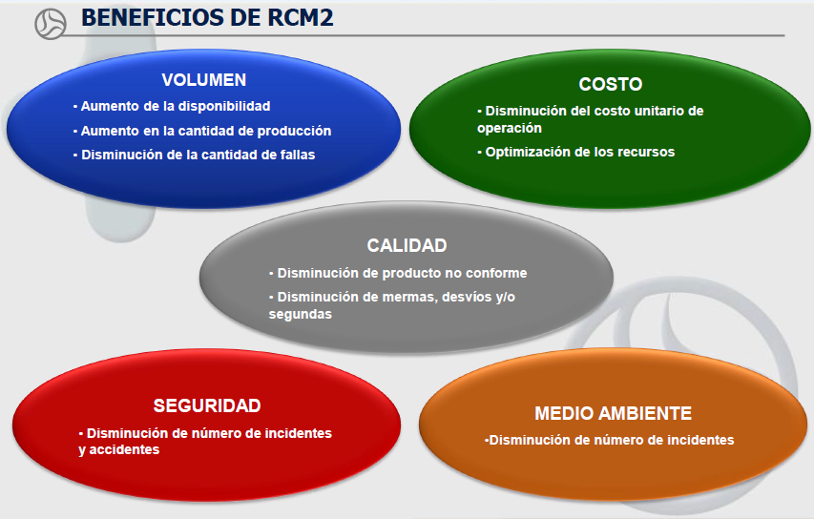
BENEFICIOS

Slide 109
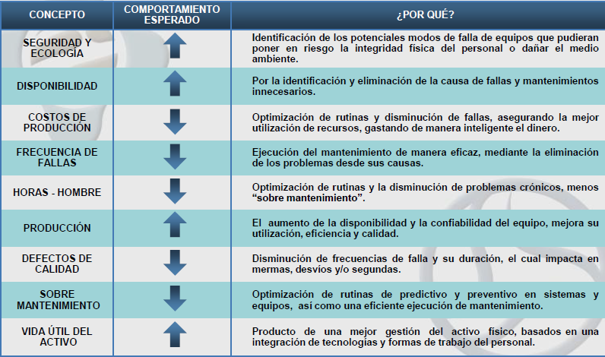
BENEFICIOS

Slide 110
UN PLAN DINÁMICO
Cada grupo deberá reunirse formalmente de nuevo,
cada 9 a 12 meses, para revisar las planillas.
PREGUNTAS CLAVES
¿CAMBIÓ EL CONTEXTO
OPERACIONAL?
¿SE MODIFICÓ EL EQUIPO?
¿CAMBIÓ ALGÚN PARÁMETRO
DE FUNCIONAMIENTO?
¿OCURRIÓ ALGÚN MODO DE FALLA
NO CONSIDERADO?
¿NECESITA CAMBIARSE LA
DESCRIPCIÓN DE ALGÚN EFECTO?
¿DEBE SER RECONSIDERADA ALGUNA
CONSECUENCIA DE FALLA?
¿TODAS LAS TAREAS CONTINUAN SIENDO “TÉCNICAMENTE FACTIBLES” Y MERECEN LA PENA”?
¿NECESITA SER CAMBIADA LA FRECUENCIA DE ALGUNA TAREA?
¿DEBE SER CONSIDERADA ALGUNA NUEVA TÉCNICA PREVENTIVA?
¿DEBE SER CAMBIADA LA PERSONA QUE REALIZA ALGUNA TAREA?

Slide 111
EJEMPLO DE PRESENTACIÓN DE LOS RESULTADOS
DE LOS ANÁLISIS DE RCM2

Slide 112
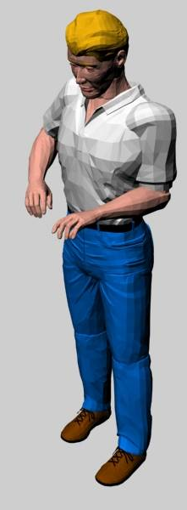
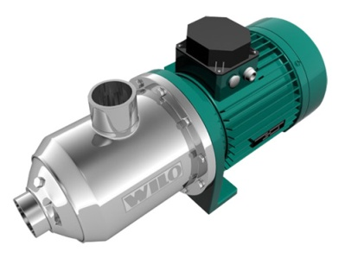
RELIABILITY CENTERED MAINTENANCE
(RCM)
ES UN PROCESO USADO PARA DETERMINAR QUÉ SE DEBE HACER
PARA ASEGURAR QUE CUALQUIER ACTIVO O SISTEMA
CONTINÚE HACIENDO LO QUE EL USUARIO NECESITA QUE HAGA.

Slide 113
LAS SIETE PREGUNTAS
¿Cuáles son las funciones y los parámetros de funcionamiento asociados al activo en su actual contexto operacional?
¿De qué manera falla en satisfacer dichas funciones?
¿Cuál es la causa de cada falla funcional?
¿Qué sucede cuando ocurre una falla?
¿En qué sentido es importante una falla?
¿Qué puede hacerse para prevenir o predecir la falla?
¿Qué debe hacerse si no se encuentra una tarea proactiva adecuada?

Slide 114
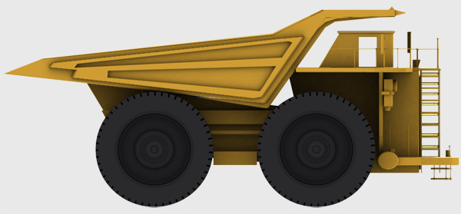
FUNCIÓN Y SUS CAPACIDADES
Sistema hidráulico del volco
Sistema eléctrico
QUÉ CAUSA QUE NO CUMPLA LA FUNCIÓN
DE QUÉ MANERA NO CUMPLE LA FUNCIÓN
Sistema de dirección
CONSECUENCIAS DE LA FALLA DE LA FUNCIÓN
LA IMPORTANCIA DE LA FALLA
Sistema motriz
Sistema de frenos
Sistema tren de potencia
QUÉ PUEDE HACERSE PARA PREVENIR LA FALLA
QUÉ HACER A FALTA DE UNA TAREA PROACTIVA

Slide 115
¿Cómo se hace?
HOJA DE INFORMACIÓN
FUNCIÓN |  | FALLA FUNCIONAL |  | MODO DE FALLA |  | EFECTO DE FALLA
1 | Proveer hasta 400 Kw de potencia a 2500 RPM al eje de entrada de la caja de cambios | A | Totalmente incapaz de proveer la potencia | 1 | No hay combustible en el tanque | 1 | Al no tener combustible en el tanque el camión se apaga durante la operación, el operador llama a la base, el mecánico de campo llega a revisar y encuentra el nivel del tanque seco, se solicita el servicio a M3 y se repone el nivel, se hace necesario desairar el sistema para dar encendido y todo este proceso puede tardar 4 horas.
 |  |  |  | 2 | Filtro de combustible tapado | 2 | SE DESARROLLA EL EFECTO
 |  |  |  | 3 | Línea de combustible tapado por un objeto extraño | 3 | SE DESARROLLA EL EFECTO
 |  |  |  | 4 | Línea de combustible cortada | 4 | SE DESARROLLA EL EFECTO

Slide 116
¿Cómo se hace?
HOJA DE DECISIÓN
Estrategia de
mantenimiento
Frecuencia
Responsable

Slide 117
¿Cómo lo vamos a hacer?
hidráulico

Slide 118
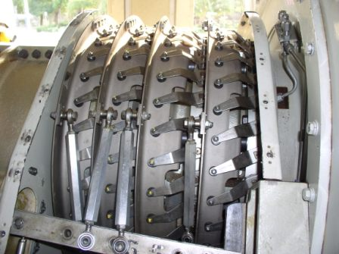
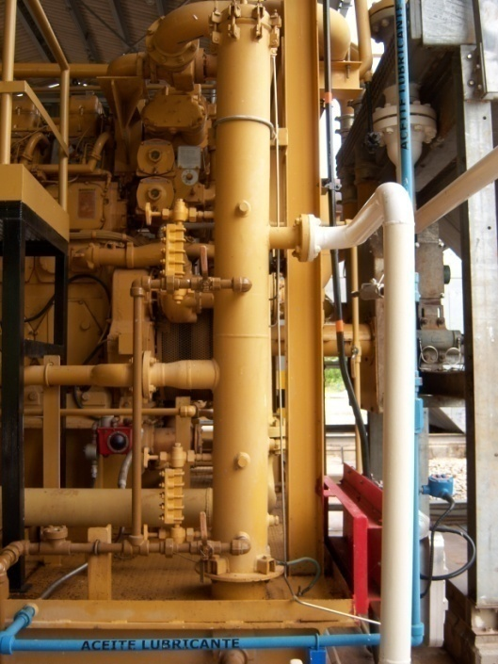
PROYECTO DE IMPLEMENTACIÓN
DE RCM2
ESTACIÓN MOTOCOMPRESORA

Slide 119
PROYECTO DE IMPLEMENTACIÓN DE RCM2
ALCANCE
EL ALCANCE DEL PROYECTO DE DESARROLLO DE RCM2 ESTA ORIENTADO A APLICAR RCM2, CUMPLIENDO CON LA NORMA SAE JA 1011, PARA LA ENTREGA DE:
  TAREAS DE MANTENIMIENTO Y ACCIONES DE MEJORA A LOS PROCESOS DE MANTENIMIENTO.
  TABLERO DE MANDO PARA MEDIR LOS RESULTADOS.
  INFORMACIÓN PARA LA OBTENCIÓN DE LAS FRECUENCIAS DE ACUERDO A LA METODOLOGÍA RCM2.

Slide 120
PROYECTO DE IMPLEMENTACIÓN DE RCM2
METODOLOGÍA USADA
RCM2 ES REALIZADO COMO UN ANÁLISIS GRUPAL DONDE TODOS LOS MIEMBROS DEL GRUPO MANEJAN EL LENGUAJE COMÚN DE RCM2.
LOS GRUPOS DE ANÁLISIS SON DIRIGIDOS Y GUIADOS POR UN FACILITADOR DE RCM2.
LAS PREGUNTAS SON REALIZADAS Y LA INFORMACIÓN RECOPILADA POR EL FACILITADOR.
LA FORMA DE HACER LAS PREGUNTAS DE RCM2 ES SOCRÁTICA Y SIEMPRE LAS DECISIONES DEBEN GARANTIZAR EL CONCENSO DEL GRUPO.

Slide 121
PROYECTO DE IMPLEMENTACIÓN DE RCM2
ETAPAS DEL PROYECTO
FORMACIÓN DE LOS ANÁLISTAS RCM2
FORMACION DE LOS FACILITADORES
2. REALIZACIÓN DE DIVISIÓN POR SISTEMAS Y DEFINICIÓN DE LÍMITES DE ANÁLISIS
REALIZACIÓN DEL CONTEXTO OPERACIONAL
4. OBTENCIÓN DE LA LISTA DE FUNCIONES

Slide 122
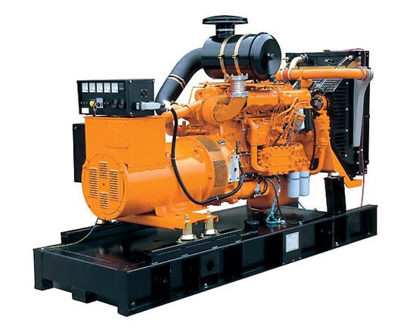
PROYECTO DE IMPLEMENTACIÓN DE RCM2
ETAPAS DEL PROYECTO
DESARROLLO DEL ANÁLISIS DE MODOS DE FALLA Y EFECTOS (FMEA).
APLICACIÓN DE LA LÓGICA RCM2
AGRUPACIÓN DE LAS TAREAS
8. PREPARACIÓN DE LA DOCUMENTACIÓN

Slide 123
PROYECTO DE IMPLEMENTACIÓN DE RCM2
CONFIGURACIÓN DE LOS GRUPOS DE ANÁLISIS
ESTACIÓN MOTOCOMPRESORA
FACILITADOR:
JUAN CARLOS OCAMPO
ANALISTA:
CARLOS MIRA
ANALISTA:
ALBERTO RUÍZ
ANALISTA:
ANTONIO PÉREZ

Slide 124
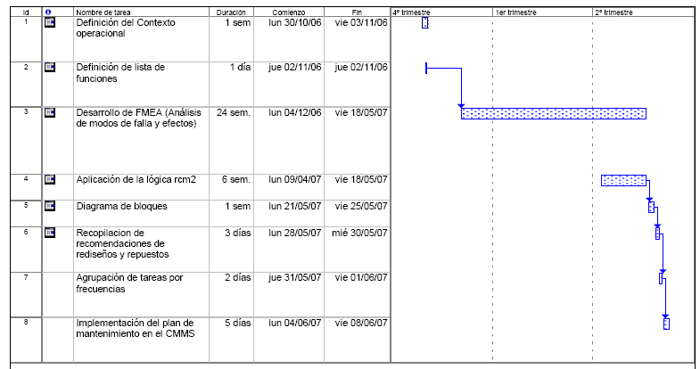
PROYECTO DE IMPLEMENTACIÓN DE RCM2
CRONOGRAMA DE IMPLEMENTACIÓN

Slide 125
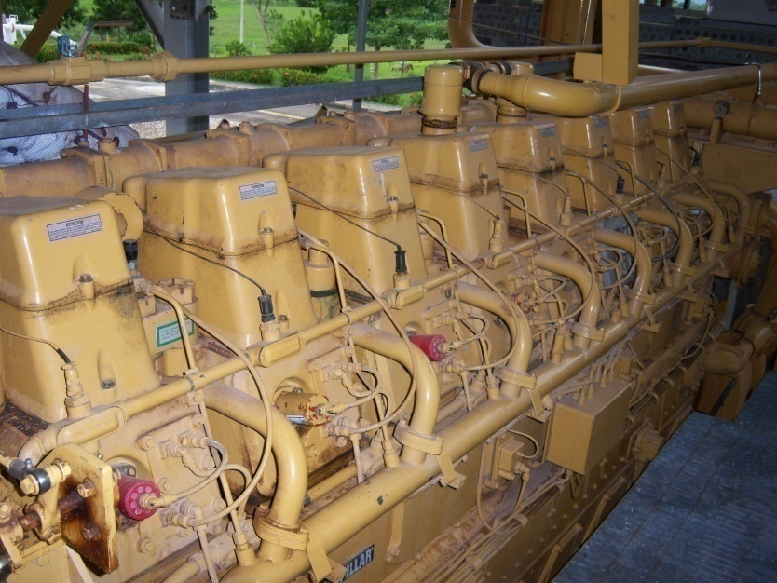
ANÁLISIS RCM2
ESTACIONES MOTOCOMPRESORAS

Slide 126
PROYECTO DE IMPLEMENTACIÓN DE RCM2
DIAGRAMA DE BLOQUES ESTACIÓN MOTOCOMPRESORA ESTACIÓN 2
EMPRESA DE GAS
Estaciones compresoras
ESTACIÓN 1
ESTACIÓN 2
ESTACIÓN 3
ESTACIÓN 4
ESTACIÓN 5
Sistema de Compresión de Gas
Sistema de Generación de emergencia
Patín de gas combustible
Patín de gas de arranque
Sistema de válvulas de patio
Sistema de enfriamiento de gas
Sistema contra incendio de la estación
Compresor
Motor
Sistema reposición de lubricante
Integridad Mecánica
Distritos

Slide 127
PROYECTO DE IMPLEMENTACIÓN DE RCM2
DIAGRAMA DE BLOQUES ESTACIÓN MOTOCOMPRESORA
ESTACIÓN 2
(CONTINUACIÓN)
Motor
Bloque
Sistema de aire y gases de escape
Sistema de arranque
Sistema de combustible
Sistema de enfriamiento
Sistema de Lubricación
Sistema Hidrax
Sistema de compresión de gas
Compresor
Bloque
Sistema de lubricación

Slide 128
PROYECTO DE IMPLEMENTACIÓN DE RCM2
RESULTADOS DE IMPLEMENTACIÓN: FUNCIONES
SISTEMA DE COMPRESIÓN DE GAS

Slide 129
PROYECTO DE IMPLEMENTACIÓN DE RCM2
RESULTADOS DE IMPLEMENTACIÓN: MODOS DE FALLA
SISTEMA DE COMPRESIÓN DE GAS

Slide 130
PROYECTO DE IMPLEMENTACIÓN DE RCM2
RESULTADOS DE IMPLEMENTACIÓN:
CONSECUENCIAS DE LAS FALLAS
SISTEMA DE COMPRESIÓN DE GAS

Slide 131
PROYECTO DE IMPLEMENTACIÓN DE RCM2
RESULTADOS DE IMPLEMENTACIÓN:
CLASIFICACIÓN DE LAS TAREAS
SISTEMA DE COMPRESIÓN DE GAS

Slide 132
PROYECTO DE IMPLEMENTACIÓN DE RCM2
RESULTADOS DE IMPLEMENTACIÓN: RESUMEN DE LA ESTACIÓN

Slide 133
PROYECTO DE IMPLEMENTACIÓN DE RCM2
RESULTADOS DE IMPLEMENTACIÓN;
COMPARACIÓN DEL PLAN DE MANTENIMIENTO
SISTEMA DE COMPRESIÓN DE GAS

Slide 134
PROYECTO DE IMPLEMENTACIÓN DE RCM2
RESULTADOS DE IMPLEMENTACIÓN;
COMPARACIÓN DEL PLAN DE MANTENIMIENTO
SISTEMA DE COMPRESIÓN DE GAS

Slide 135
PROYECTO DE IMPLEMENTACIÓN DE RCM2
RESULTADOS DE IMPLEMENTACIÓN
DISTRIBUCIÓN DEL TIEMPO EN EL PROYECTO
(Horas de reunión)

Slide 136
AVANCE DEL CASO
Contexto operacional
Mejoras a la gestión de Compras / Inventarios
100%
Diagrama de bloques
90%
80%
100%
Recomendaciones de adquisición / mejora de herramientas
Diagramas de entradas y salidas
70%
60%
50%
Entrenamientos realizados
35%
Diagramas unifilar o planos
40%
25%
30%
50%
20%
40%
Repuestos dados de alta
10%
10%
25%
100%
Lista de funciones
32%
0%
25%
100%
Modificación de procedimientos
90%
25%
Análisis de modos de fallas y efectos
30%
80%
45%
50%
Implementación de procedimientos
Diagrama de decisión RCM2
Implementación de rediseños
Análsis de sistemas por separado
Implementación de grupo de tareas de mantenimiento en el
Agrupación de tareas por frecuencia
CMMS

Slide 137

PROYECTO DE IMPLEMENTACIÓN DE RCM2
CAMBIOS ÚNICOS EN EL SISTEMA
ESCRIBIR PROCEDIMIENTO DE PURGADO DEL REFRIGERANTE EN EL MOTOR
ADICIONAR EN EL FORMATO DEL OPERADOR UNA VERIFICACIÓN QUE EL CALENTADOR SE APAGUE DESPUÉS DE CADA ARRANQUE
ENTRENAR A LOS OPERADORES PARA EL PROCEDIMIENTO EN CASO DE QUE SE ATASQUE EL ROD END.

Slide 138
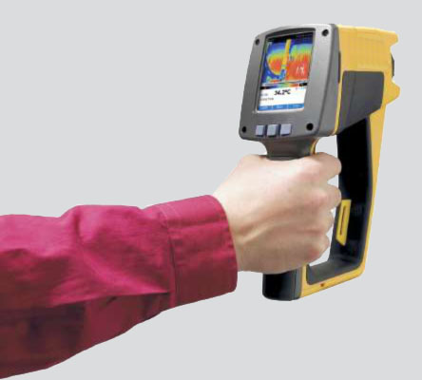
PROYECTO DE IMPLEMENTACIÓN DE RCM2
CAMBIOS ÚNICOS EN EL SISTEMA
MANTENER EL SHIELD DEL MOTOR EN INVENTARIO
ESCRIBIR EL PROCEDIMIENTO PARA USO DE LA HERRAMIENTA DE GIRO MANUAL QUE INCLUYA LA VERIFICACIÓN AL FINAL DE UNA INTERVENCIÓN, QUE LA HERRAMIENTA DE GIRO MANUAL ESTA DESENGRANADA
COMPRAR HERRAMIENTA ADECUADA PARA LA MEDICIÓN DE LA PROYECCIÓN DE VÁLVULAS

Slide 139
PROYECTO DE IMPLEMENTACIÓN DE RCM2
CAMBIOS ÚNICOS EN EL SISTEMA
MANTENER LA VÁLVULA DE PRIORIDAD EN STOCK
REDISEÑAR EL SISTEMA DE CONTROL DE LA VÁLVULA DE RECIRCULACIÓN DE LA ESTACIÓN.
REENTRENAR A LOS OPERADORES EN EL USO DE LA VÁLVULAS REGULADORAS DE PRESIÓN DE LA ESTACIÓN
INSTALAR UN SISTEMA DE MEDICIÓN DE VOLUMEN EN LOS VENTEOS DE LA ESTACIÓN

Slide 140

PROYECTO DE IMPLEMENTACIÓN DE RCM2
ETAPAS POSTERIORES
UNA VEZ TERMINADO LOS ANÁLISIS ES NECESARIO QUE LAS DECISIONES SEAN IMPLEMENTADAS EN EL CMMS, LO QUE IMPLICA:
  MODIFICAR O BORRAR EL PLAN DE MANTENIMIENTO ANTERIOR.
  INGRESAR LA INFORMACIÓN DE LAS TAREAS DE MANTENIMIENTO.
  INGRESAR NUEVAS FRECUENCIAS.
  MONITOREAR LAS VARIABLES NECESARIAS PARA REAJUSTAR LAS FRECUENCIAS DE LAS TAREAS DE BÚSQUEDA DE FALLAS.

Slide 141
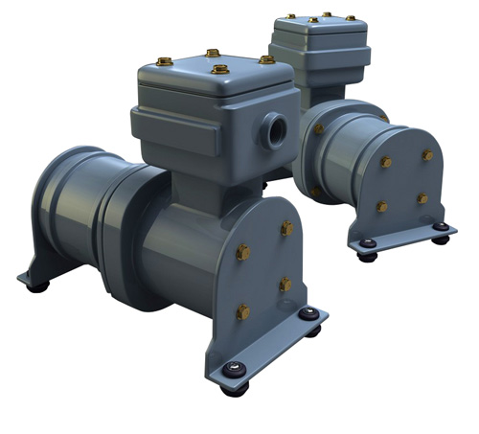
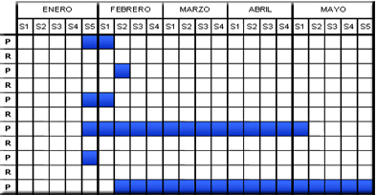
PROYECTO DE IMPLEMENTACIÓN DE RCM2
ETAPAS POSTERIORES
DETERMINAR LOS MECANISMOS PARA ASEGURAR QUE EL PLAN DE MANTENIMIENTO OBTENIDO CON RCM2 SE CUMPLA DE ACUERDO A LO ESTABLECIDO.
IMPLEMENTAR TODOS LOS REDISEÑOS OBLIGATORIOS (CONSECUENCIAS QUE IMPACTAN LA SEGURIDAD O EL MEDIO AMBIENTE).
JUSTIFICAR LOS REDISEÑOS NO OBLIGATORIOS (CONSECUENCIAS OPERACIONALES Y NO OPERACIONALES.
REALIZAR Y MODIFICAR LOS PROCEDIMIENTOS QUE SE REQUIERAN.

Slide 142
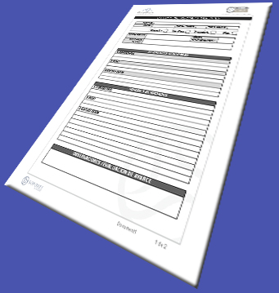
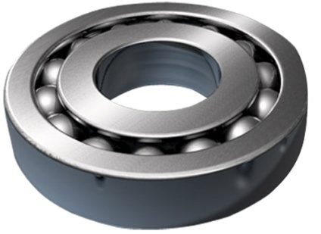
PROYECTO DE IMPLEMENTACIÓN DE RCM2
ETAPAS POSTERIORES
REALIZAR LOS ENTRENAMIENTOS REQUERIDOS A OPERADORES Y MANTENEDORES.
REVISAR EL INVENTARIO DE REPUESTOS Y HERRAMIENTAS Y DAR DE ALTA LOS REPUESTOS SUGERIDOS EN EL ANÁLISIS.
REVISAR Y HACER UN PROGRAMA DE MEJORAMIENTO DE LAS COMPETENCIAS DE LAS PERSONAS QUE EJECUTARÁN EL PLAN Y ANALIZAR LA NECESIDAD DE CONTRATACIÓN DE NUEVO PERSONAL PARA STAFF DE MANTENIMIENTO Ó DE REDISTRIBUCIÓN DE CARGAS SOBRE TODO PARA ACTIVIDADES DE INSTRUMENTACIÓN.

Slide 143

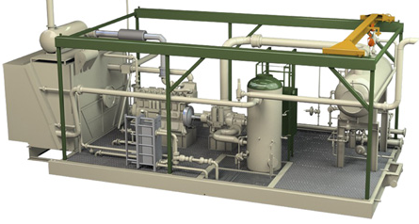
PROYECTO DE IMPLEMENTACIÓN DE RCM2
CONCLUSIÓN DEL ANÁLISIS
EL 60% DE LOS MODOS DE FALLA DE LA ESTACIÓN CORRESPONDEN A SOBRECARGAS DE LOS EQUIPOS O SON CAUSADOS POR MALA OPERACIÓN, PARA ELLO SE DEBE REALIZAR UN REENTRENAMIENTO DE LOS OPERADORES.
EL COSTO DE MANTENIMIENTO ANUALMENTE SE REDUCIRÁ EN UN 15% DEBIDO A 235 TAREAS ANUALES QUE SE DEJARÁN DE REALIZAR, ESTA REDUCCIÓN CORRESPONDE A 120.000.000 DE PESOS ANUALMENTE.

Slide 144
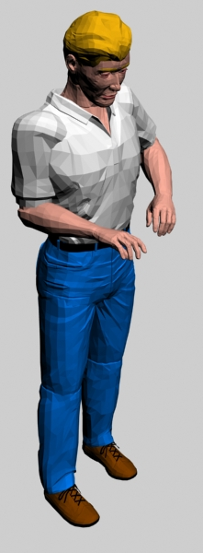
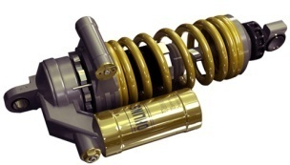
PROYECTO DE IMPLEMENTACIÓN DE RCM2
CONCLUSIÓN DEL ANÁLISIS
SE RECOMIENDA CONTRATAR UN INSTRUMENTISTA, YA QUE EL 25% DE LAS TAREAS DE LA ESTACIÓN SON DE VERIFICACIONES METROLÓGICAS Y LOS TÉCNICOS DE LA ESTACIÓN NO CUENTAN CON ESTAS COMPETENCIAS.
EL 70% DE LAS ACTIVIDADES REALIZADAS POR EL CONTRATISTA EXTERNO, SE PUEDEN REALIZAR CON LOS TÉCNICOS DE LA ESTACIÓN Y SE RECOMIENDA QUE CUANDO SE CONTRATEN TAREAS SE HAGA UNA SUPERVISIÓN DE LAS INTERVENCIONES POR PARTE DE LA COMPAÑÍA.

